Slide 1
East Lewis County Public Development Authority
“Unleashing Potential, Transforming Communities & Building a Better Tomorrow."

Slide 2
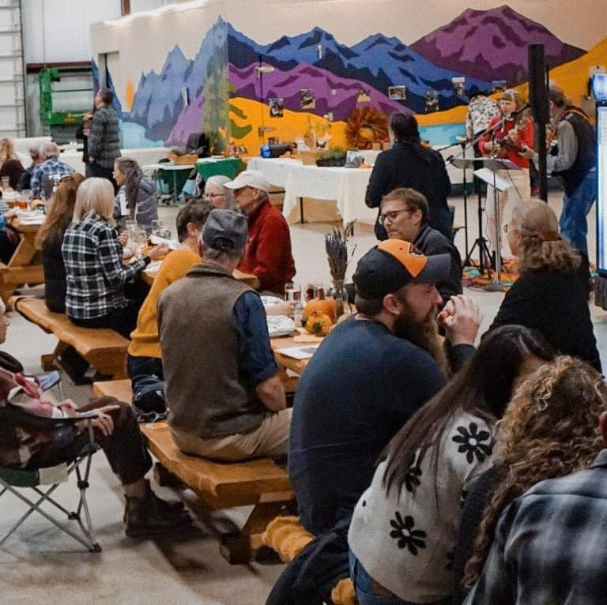
Agenda
Strategic Goals 2024
Our Mission
Accomplishments
Our Future
Your Partnership

Slide 3
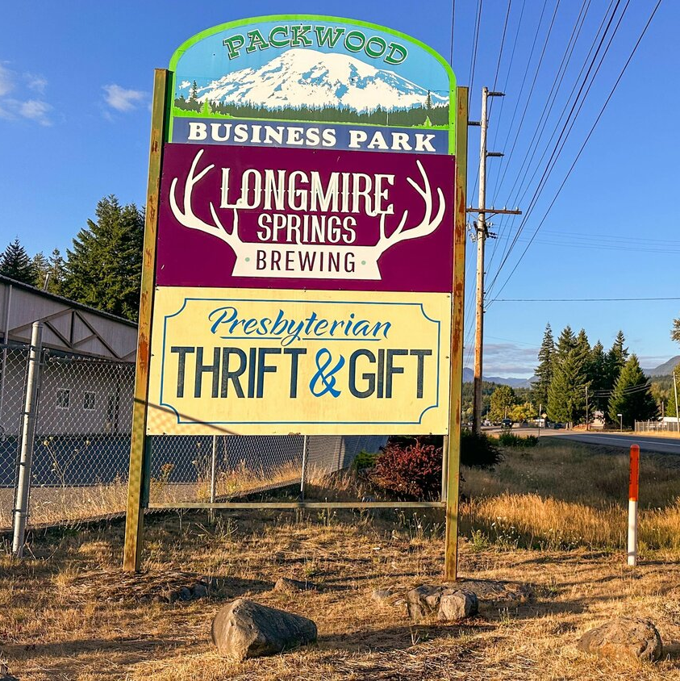
Goals
2024
Diversify PDA board of directors
Address backlog of maintenance needs at the Packwood Business Park
Collaborate with businesses and partners to revitalize the business park campus

Slide 4
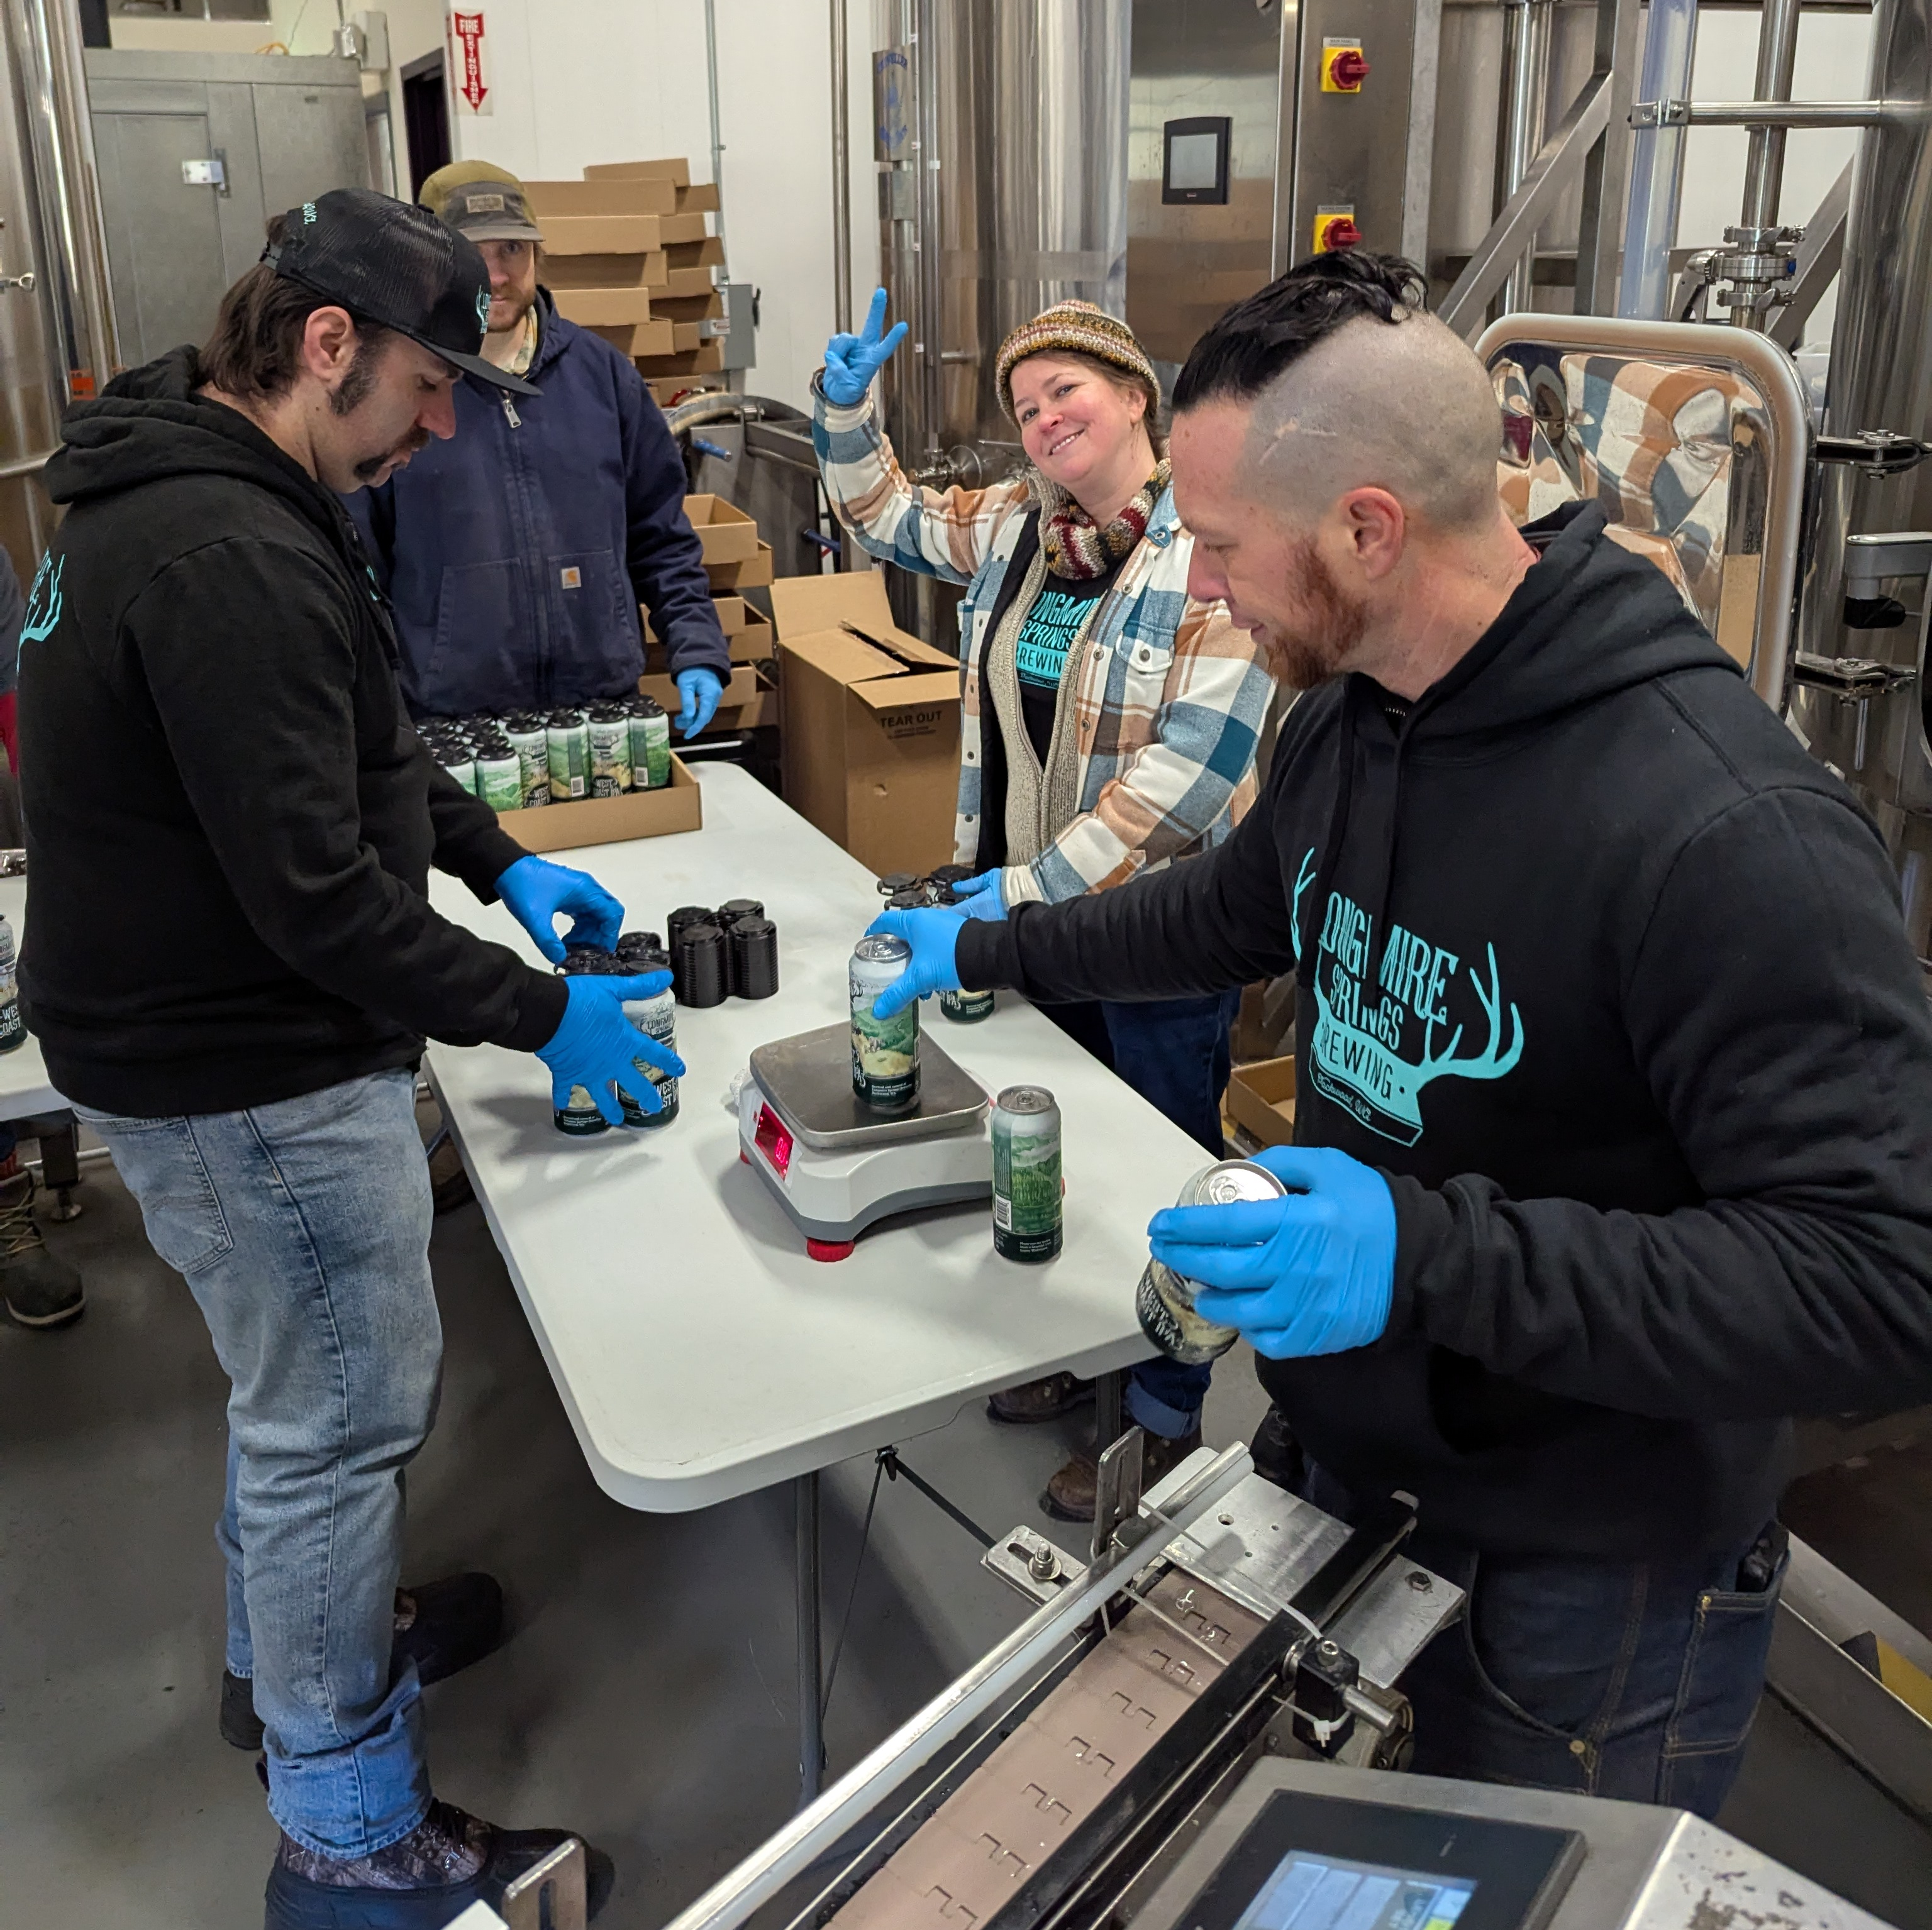
Our mission is to attract and support new businesses, create new jobs, facilitate infrastructure development, and offer services to address various county concerns.
Created 5 Living Wage Jobs: We are proud to have played a part in providing stable, well-paying employment opportunities within our community.
Supporting 2 Additional Businesses: In addition to Longmire Springs, the business park serves as a home base for two local businesses, which together employ an additional 5 people.
Empowering Small Businesses & Artisans: We provide space for dozens of small businesses and artisans, helping them connect with the community and generate life sustaining income through sales.
Fostering Community Connection Through Volunteerism: The Thrift & Gift engages 20 local volunteers, mostly seniors, providing meaningful opportunities for them to stay connected and contribute to the community.

Slide 5
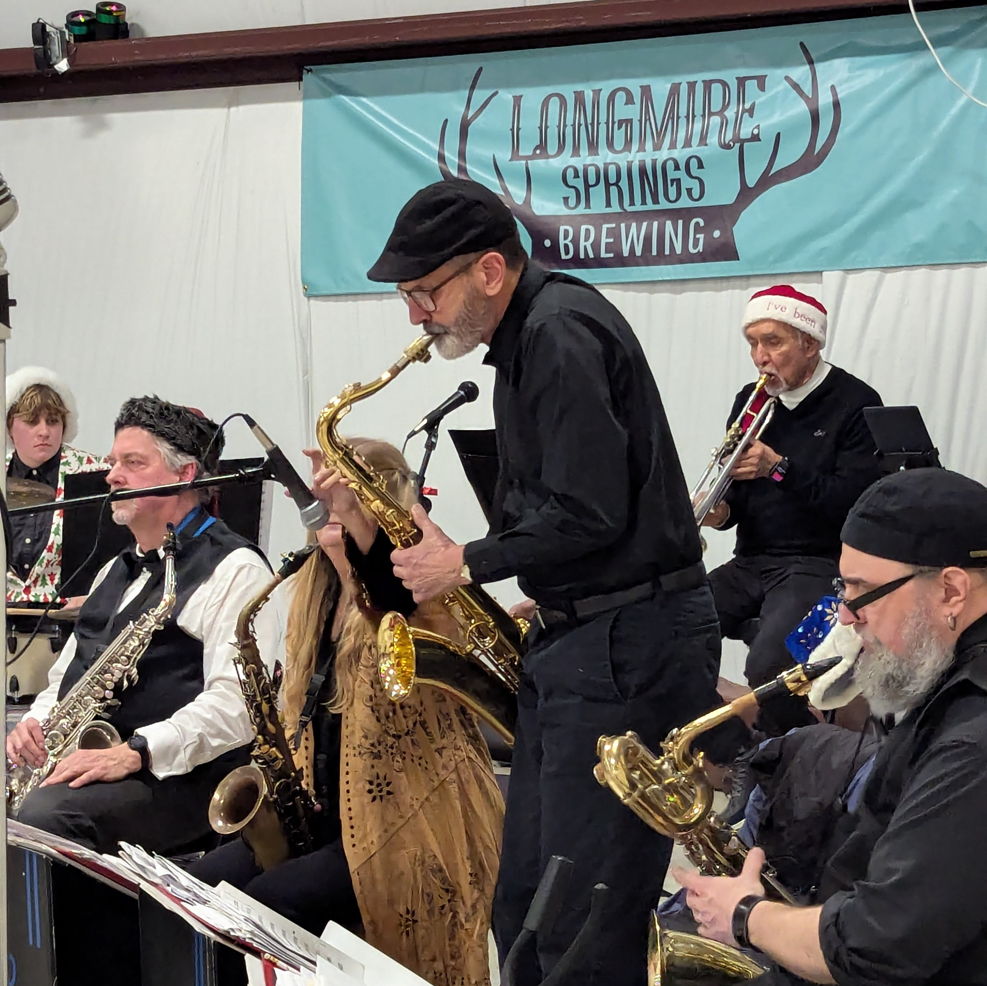
Beyond Goals:
Building Community
“It had been decades since I had seen live jazz and I wasn’t sure I’d ever get to experience that again as I can’t drive very far these days. What a joy it was to get to see a 13-piece band twice this year! I even got to dance!” – Longmire Springs Patron
Over 150 free, live music events hosted Ranging from jazz to country to reggae and more

Slide 6

Beyond Goals:
Building Community
Over 40 Classes ranging from jewelry making to cooking to hat burning and Collage

Slide 7
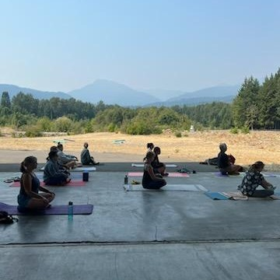
Beyond Goals:
Building Community
Hosted 40 “Pay as you can” Wellness and Fitness classes

Slide 8
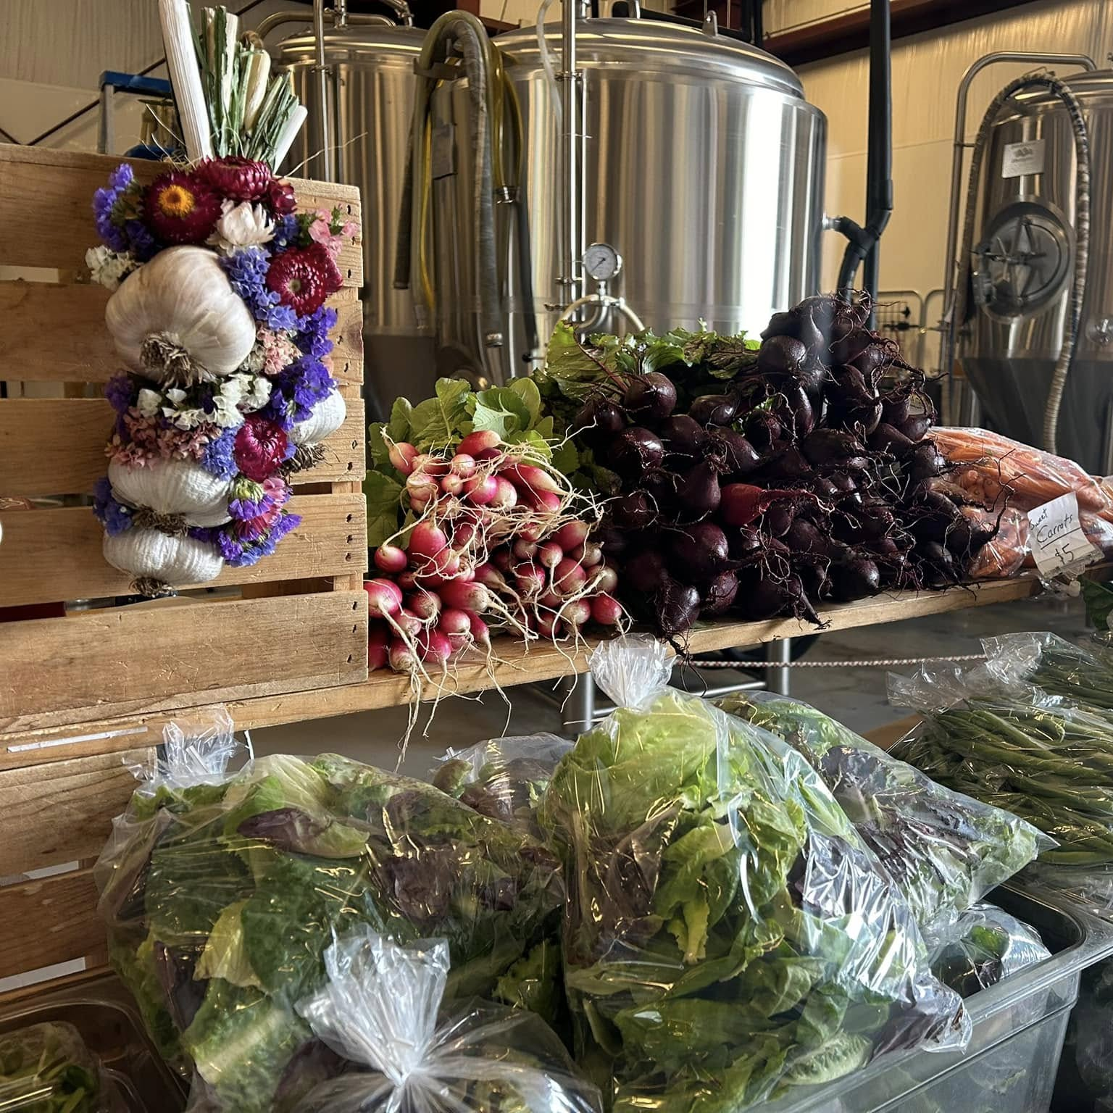
Beyond Goals:
Building Community
Provided space to the packwood Saturday market at no cost so that vendors could extend their season & Revenue by four months

Slide 9
Beyond Goals: Giving Back
Over $25k in Charitable giving &
In-Kind donations
Thrift & Gift makes donations to:
Fire Mountain Arts Council
Delta Rising Youth Group
Timberland Library
Friends of the Library
Livable Packwood
Packwood Trail Project
Packwood Senior Center
Packwood Early Learning Center
The Roxie Theater
Gifford Pinchot Trashforce
White Pass School
White Pass County Museum
White Pass Food Bank
White Pass School Scholarships
Longmire makes donations to:
Friends of the Library
Livable Packwood
Packwood Senior Center
Rimrock Fire Victims
Onalaska Farm Sanctuary
Mt. Rainier National Park
White Pass Ski Patrol
White Pass High School
The Packwood Saturday Market
White Pass County Historical
Pinchot Partners
Habitat for Humanity

Slide 10
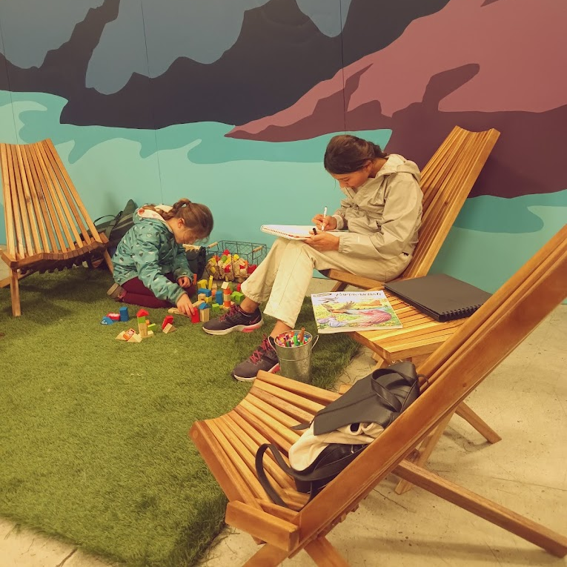
Our Future
Continue to address deferred maintenance at the business Park so that we may attract Additional businesses and be good stewards of our resources

Slide 11
Critical Improvement Projects to Complete in 2025
Paint Thrift & Gift Building - $6500
Level and improve parking lot - $14,000
Lighting at the road & throughout the campus – TBD
Additional concrete pads to support food trucks – TBD
Electrical upgrades to support food trucks and vendors

Slide 12
2025 Projected Revenue Over Expense
Revenue
Rental Income Thrift & Gift | $ 32,440.56
Rental Income Longmire | $ 40,622.40
 | $ 73,062.96
Expenses
Insurance | $ 14,573.00
Cost to Publicly Post Meetings | $ 500.00
WA State Department of Rev 12.84% | $ 9,400.00
Professional Fees | $ 10,000.00
General Repairs & Maintenance | $ 2,500.00
 | $ 36,973.00
Revenue/Expenses | $ 36,089.96

Slide 13
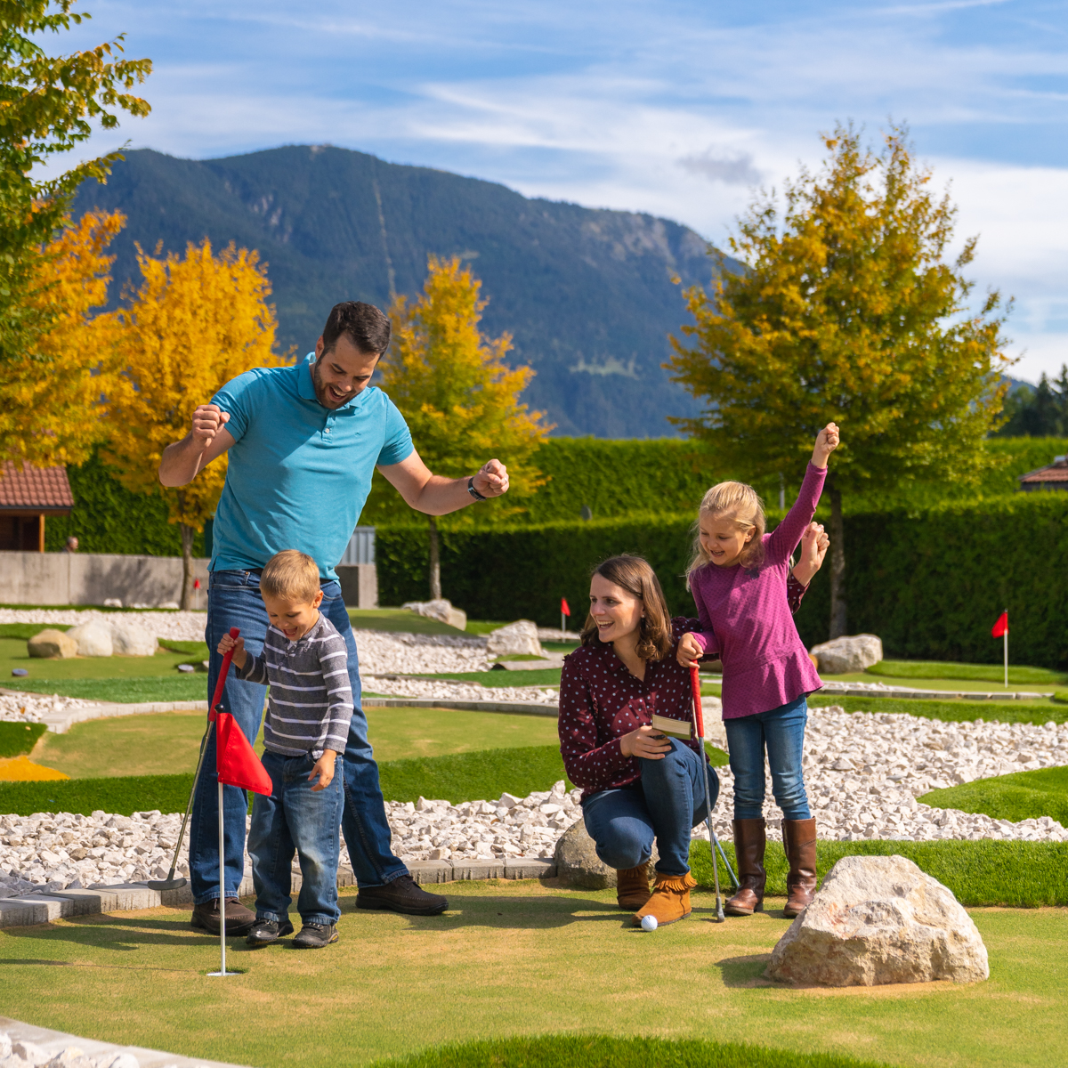
Our Future
In 2025, We plan to bring at least 1 more business to the business park and add 1 to 2 more living wage jobs

Slide 14
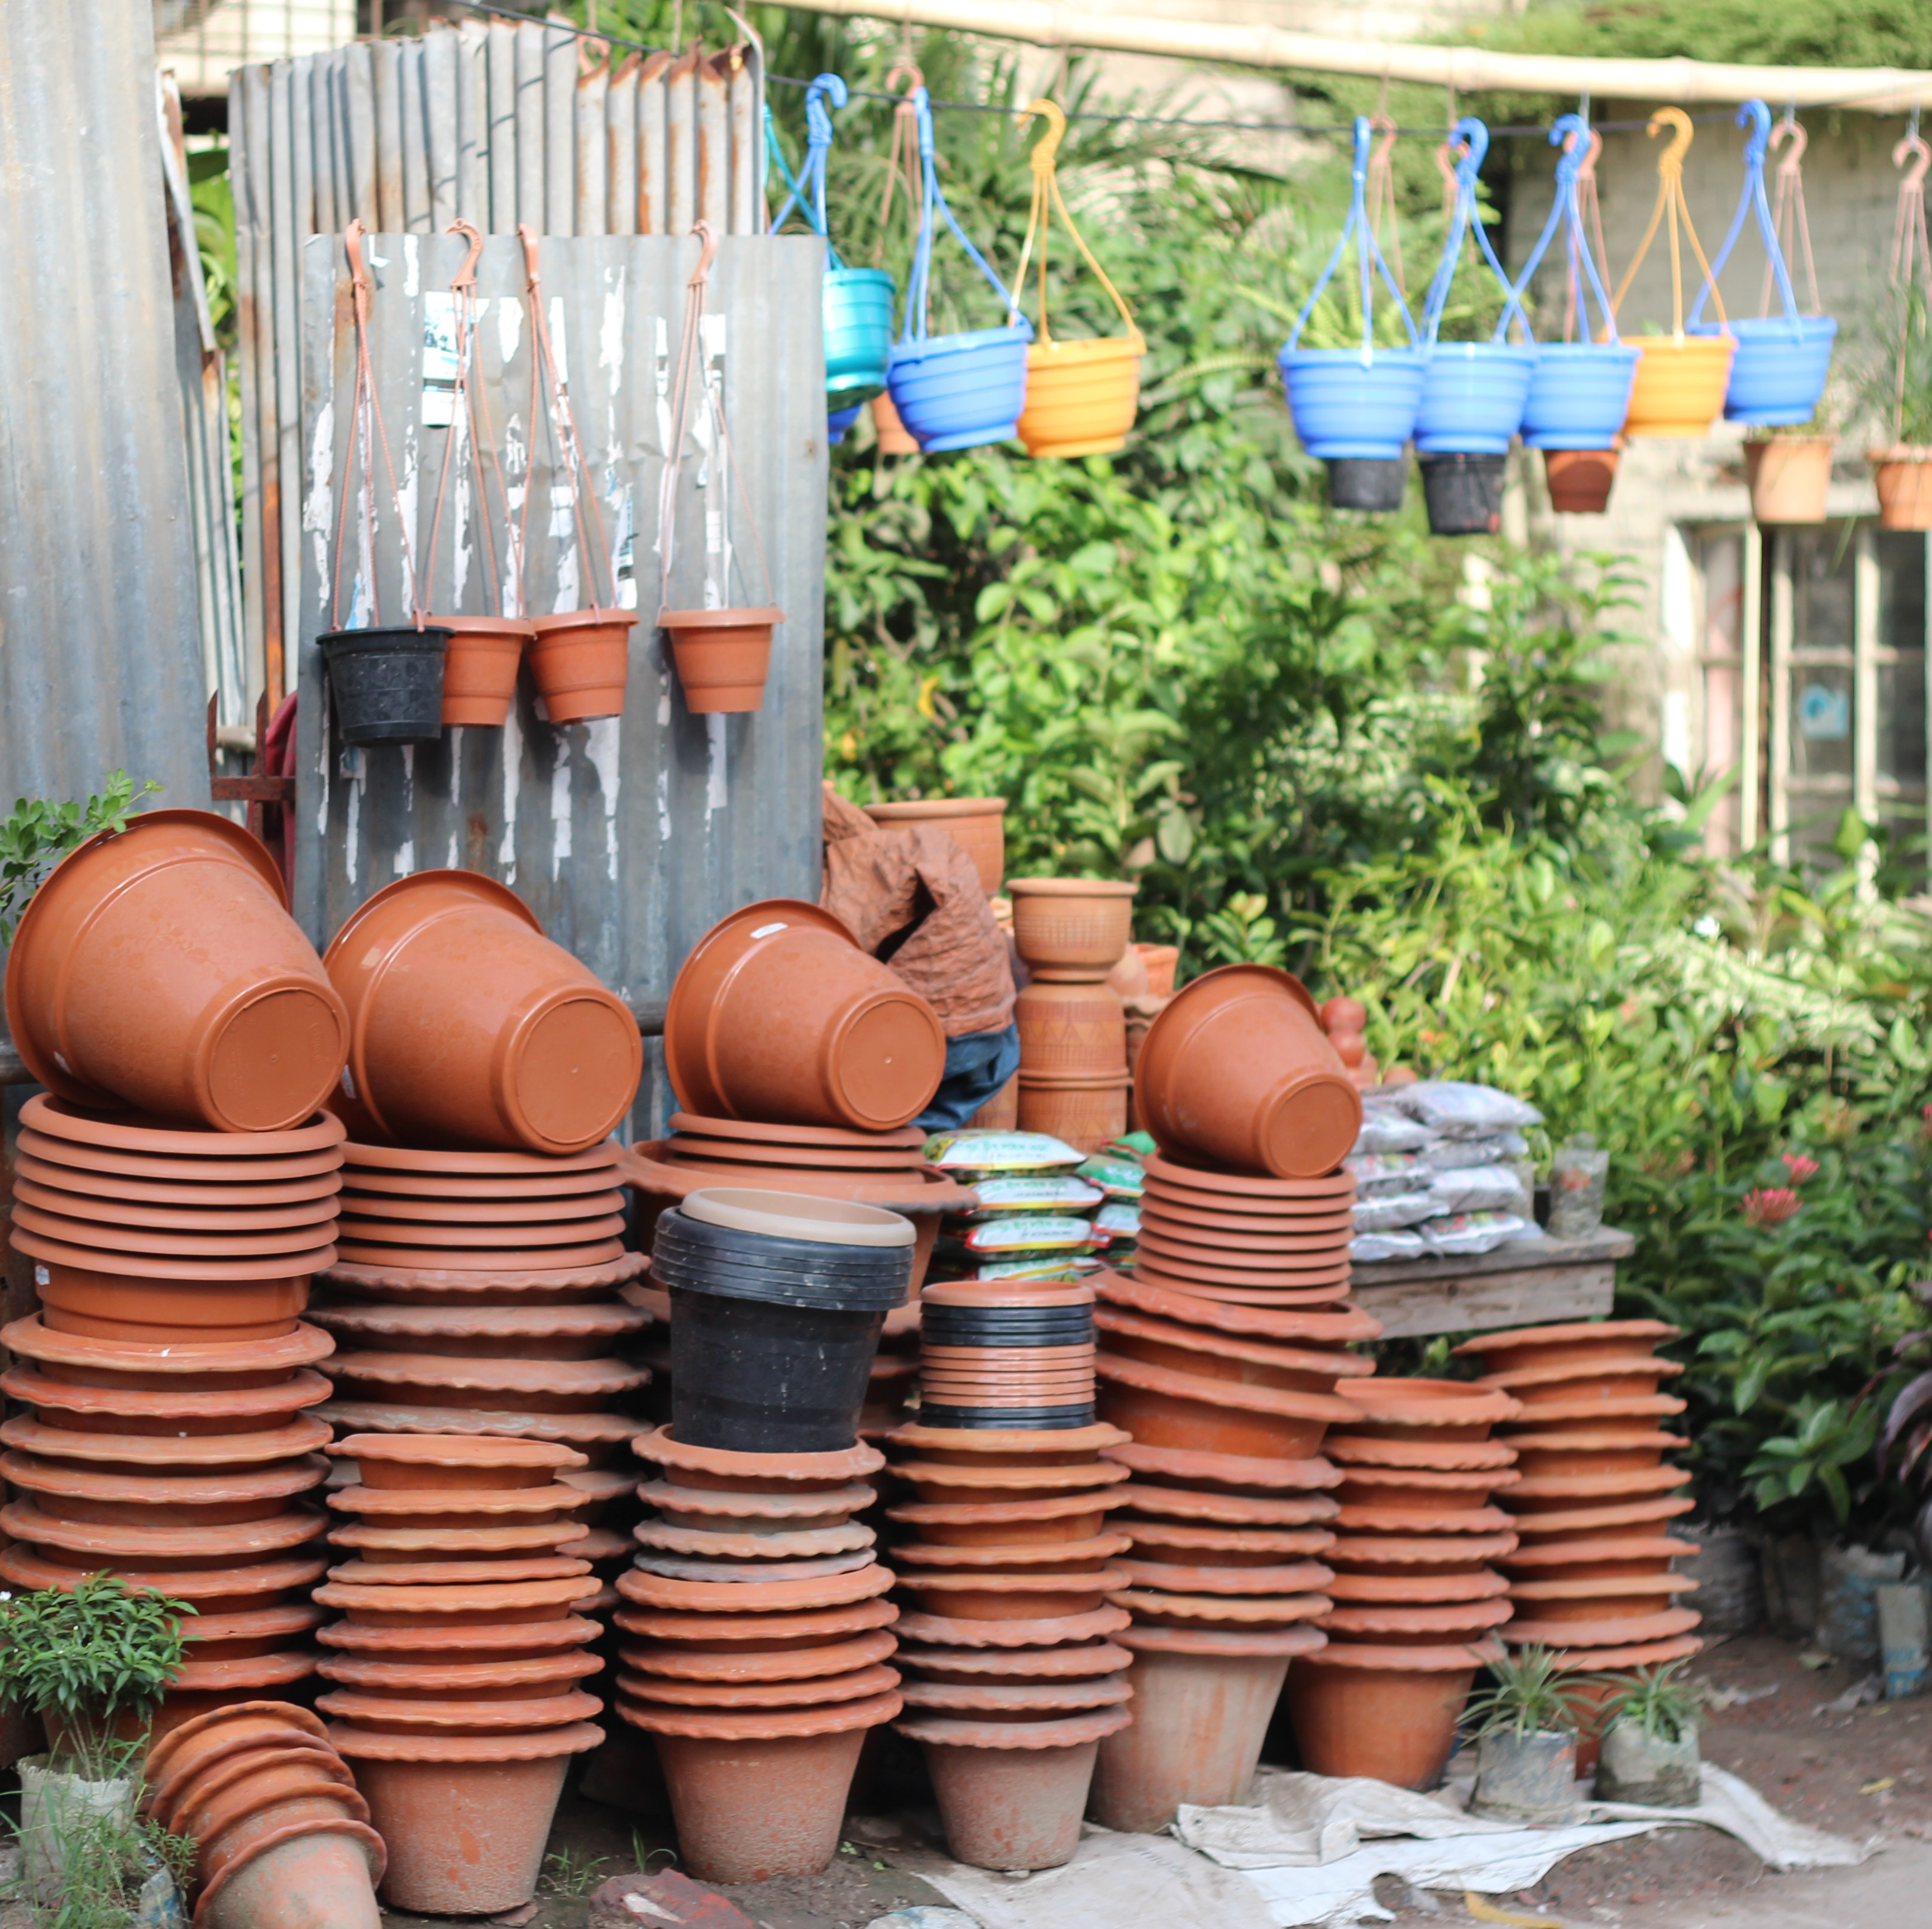
Our Future
Continue to support the businesses we currently have as tenants so that they may grow & thrive

Slide 15
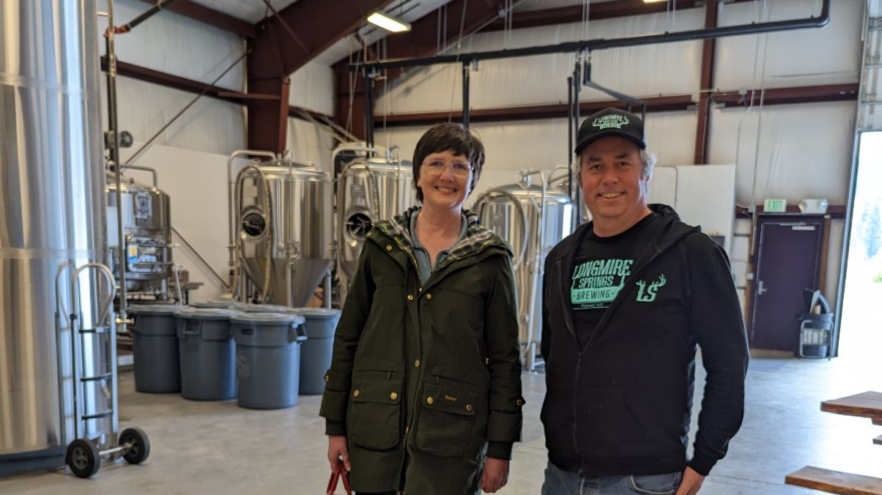
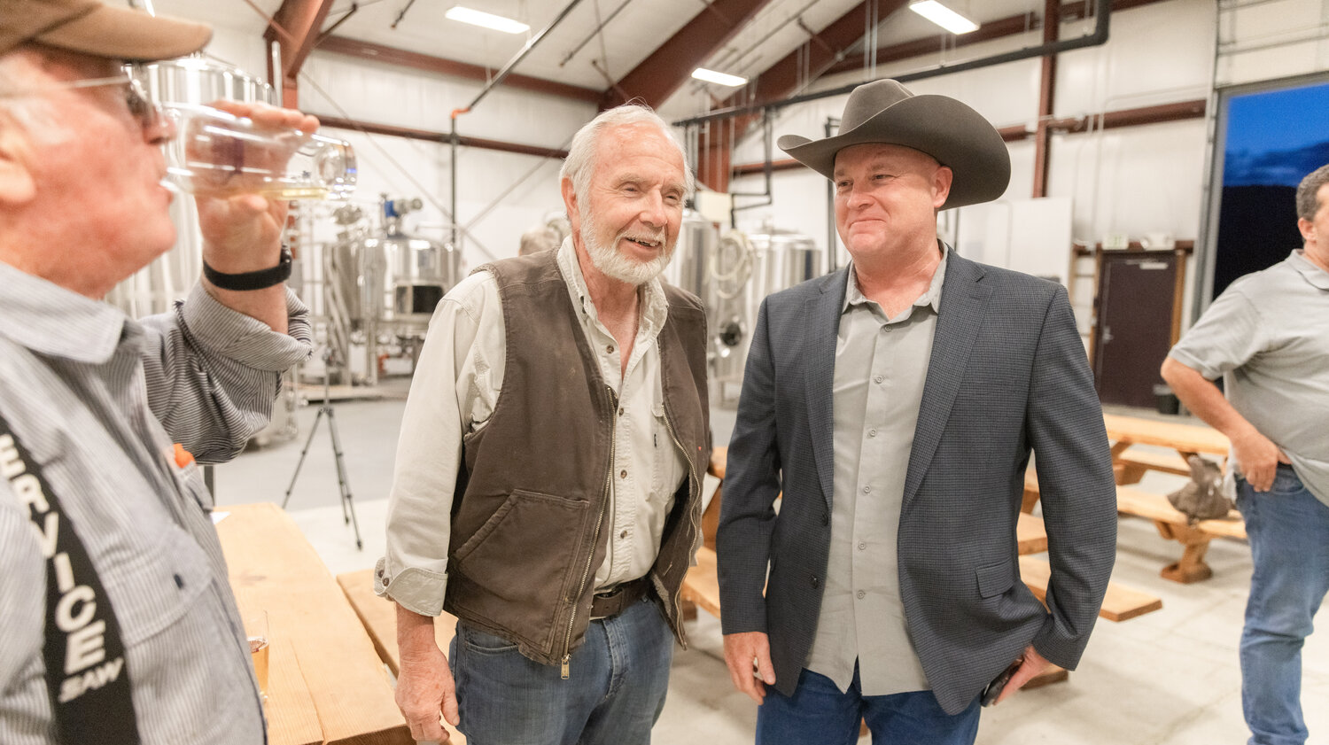
Our Partnership

