Slide 1

Lewis County PUD
BROADBAND
BOCC COVID-19 Funding
28 April 2021

Slide 2
Planning Pillars
Cost Effective
Future Proof
Technology Neutral
Equal Access
Scalable

Slide 3
Broadband Timeline
2020
2021
2022
2023
2024
2025
Backbone Construction & Detailed Design Plan
Construction and Activation
Deploy funded construction.
Seek further grant funding for each service zone.
Activate customers
Construction and Activation
Deploy funded construction.
Seek further grant funding for each service zone.
Activate customers
Funding & Asset Planning
Acquire additional inventory and assets.
Deploy funded construction.
Seek further grant funding for each service zone.
Construction and Activation
Deploy funded construction.
Seek further grant funding for each service zone.
Activate customers
Broadband Study
Secure deployment partnerships.
Acquire initial inventory and assets
Technical Design
Business Plan & Model
Seek grant funding
Advocate for authority.
Gather Data and Assess Community Needs.
Establish the PUD’s Role in providing access.
Seek grant funding.
Advocate for authority.

Slide 4


GRAYS HARBOR
THURSTON
GRAYS
HARBOR
GRAYS HARBOR
PACIFIC
LEWIS
Fords Prairie
THURSTON
Elbe
LEWIS
PIERCE
LEWIS
Chehalis
Pe Ell
Bunker North
Forest
Packwood
Napavine
PACIFIC
Napavine
LEWIS
Silver Creek
Bunker South
Morton
Winlock
Randle
Mossyrock
Glenoma
Toledo
Vader
LEWIS
LEWIS
WAHKIAKUM
COWLITZ
LEWIS
SKAMANIA
WAHKIAKUM
COWLITZ
COWLITZ
SKAMANIA
Preliminary Network Service Zones
LPUD Design Service Zones
µ
0 1.75 3.5 7 10.5
Miles
Source: Esri, DigitalGlobe, GeoEye, Earthstar Geographics, CNES/Airbus DS, USDA, USGS, AeroGRID, IGN, and the GIS User Community

Slide 5
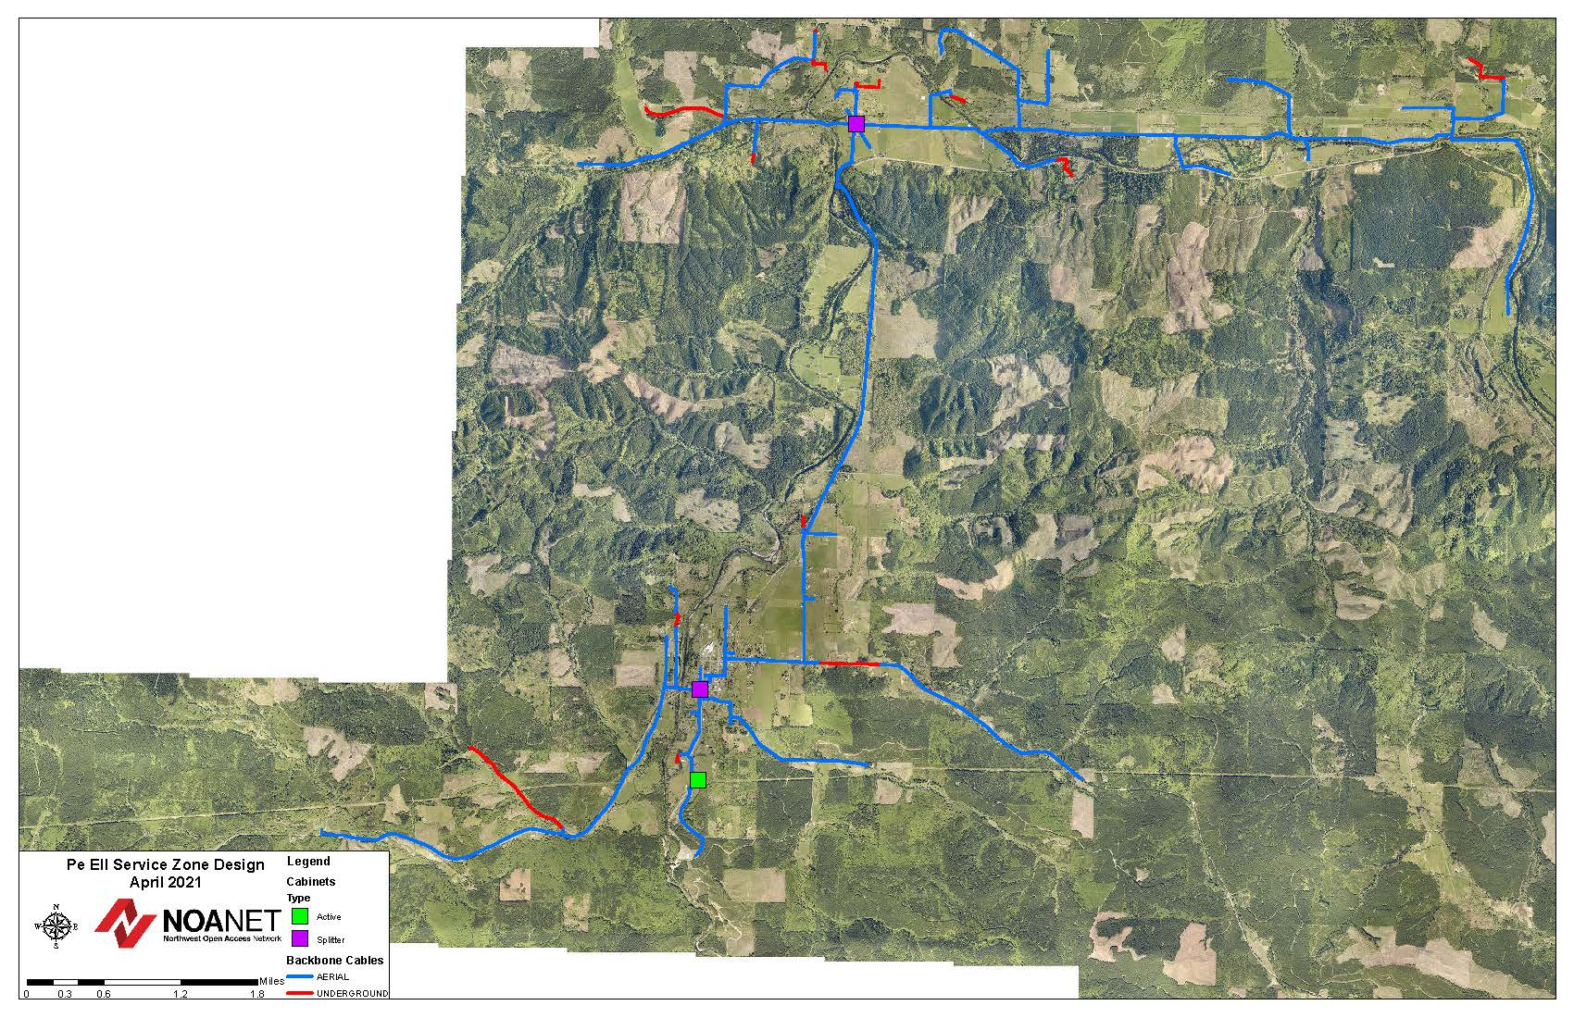
Preliminary Pe El Backbone Network Design
Modular service zone design which allows for a system wide overlay and construction. A modular design also allows for a zone-by-zone construction process.
(Does not include “backhaul”)

Slide 6
Funding Sources
USDA (Federal)
PWB (State)
CERB (State)
Stimulus (Federal)
Local / Private
SBO (State)
PUD

Slide 7
Next Steps
May - Analyze legislative outcomes and the possibility for retail authority.
June - Finalize the draft system design study and configuration.
June - Finalize the draft business plan and pro-forma financials.
July – PUD strategic plan review.
July / December – Grant submission.
Critical Path
The PUD has secured quotes for 60 reels of “backbone” fiber estimated to cost $1M. This procurement will increase the likelihood of being considered a “shovel ready” project.
The PUD is looking for ways to fund this purchase.
System Design
Inventory Procurement
Contracting services for the “siting, make ready, and construction”

Slide 8
Thank You

Slide 9
Definitions
Wholesale Dark Fiber (PUD Model)
Utility supplies dark fiber to retailers that desire Point to Point infrastructure for end user services
Wholesale Lit Network
Full service network providing both infrastructure and bandwidth to retailers
Bandwidth
Capacity available from a single strand of fiber.
Last Mile / Fiber to the Home (FttH)
Infrastructure built from a community hub all the way to the customers home.
Middle Mile
Infrastructure from the backbone to local community hubs
Backbone
Infrastructure from point to point locations. Often from a regional network hub or similar location to another hub.
Local Utility District (LUD)
Customers petition the PUD to develop infrastructure. A lending institution funds the project with proceeds from PUD collected funds from the LUD participants.
Fiberhood
  Customers commit to service; once an area has enough commitment it turns into a fiberhood (75% commitment). Customers (subscribers) pay a monthly fee for a set number of years to their ISP to repay the capital costs of building the network.
Open Access Network
A network equally available for providers to use and compete with.

Slide 10
Model | Infrastructure | Services | Relationship | Operators
Full Service Wholesale | Broadband Dark Fiber Wireless | Service to Eligible Institutions and Business (aka BPA) | Retailers compete | PUD’s and NoaNet
Wholesale Dark Fiber and conduit | Dark Fiber | Dark Fiber on Right Of Way | Retailers compete | Lewis PUD Grays Harbor PUD Port of Whitman
Wholesale Broadband or Dark Fiber to the Home | Broadband Dark Fiber Wireless | Fiber to the home | Retailers compete | Grant PUD Chelan PUD Douglas PUD
Private Partner Wholesale Broadband or Dark Fiber to the Home | Bandwidth | Fiber to the Home | Partner retailers lease network for a term and operate sole source network | Port of Whitman
Fiberhood / LUD’s (Limited Utility Districts) | Bandwidth | Fiber to the Home | Retailers compete | Mason PUD Kitsap PUD
Public Private Partnerships | Bandwidth Dark Fiber Wireless | Fiber to the home Community Wireless | Partner retailers share in the cost to deploy fiber | Franklin PUD Lewis PUD – Wave Broadband
Policy Only | Shape public policy to support expansion by private sector |  |  | Many PUD’s

