Slide 1
Facility Renewal Projects
Lewis County Jail & Department of Health Buildings
July 19, 2022
Notes:
Very nice to meet you all, thank you for your time today. We are from Millig Design Build and today we are going to talk about the projects at the Jail and Health Buildings.

Slide 2
Today’s Agenda
Introductions
Summary of current conditions at Jail and Health Buildings
Scope of Work
Project Financials
LOCAL Loan, utility incentives, and grants
Open Discussion

Slide 3

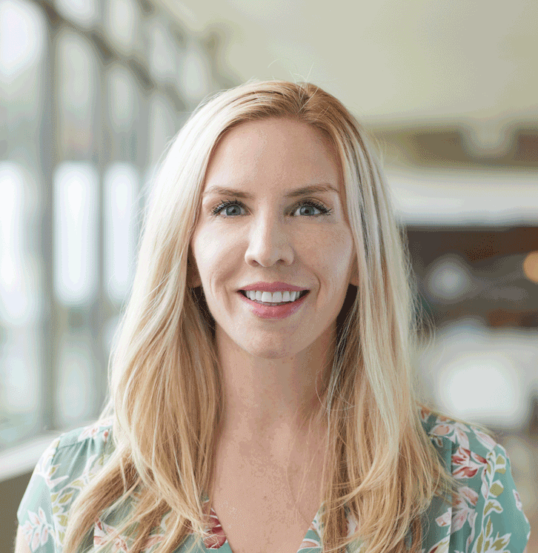
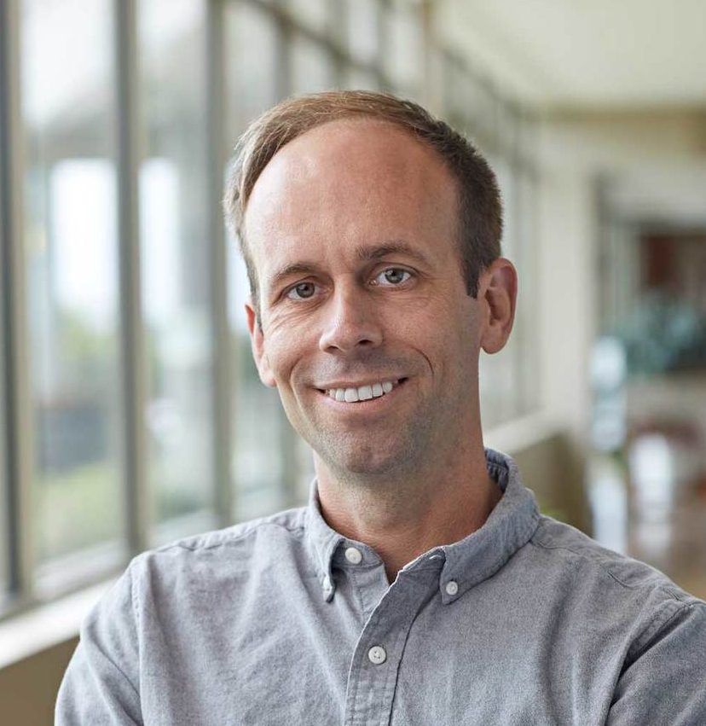
Introductions
Millig Design Build is an integrated engineering, design, and construction firm specializing in facility improvements that address energy efficiency, building health and safety, and core infrastructure needs.
Lauren Donley, CEM, CBCP
Project Development Lead
Scott McVey, PE
Project Manager & Lead Mechanical Designer
Notes:
My name is Lauren Donley and i am the co-founder of Millig Design Build and I am Lewis County’s point person on the development of these projects. I have been working Lewis County a long time, in fact, Doug has seen me go through two pregnancies and now my oldest is four and a half if that tells you anything. As i said, its my responsibility to manage all of moving pieces of a project like this - including Millig’s internal team, the county, interactions with state agencies like DES for ESPC and Dept of Commerce for Clean Buildings, utilities for incentives, writing multiple grants on behalf of the county, and everything else. Sitting next to me is Scott McVey, Millig’s principle in charge and our internal PM for the project. Scott, go ahead:

Slide 4
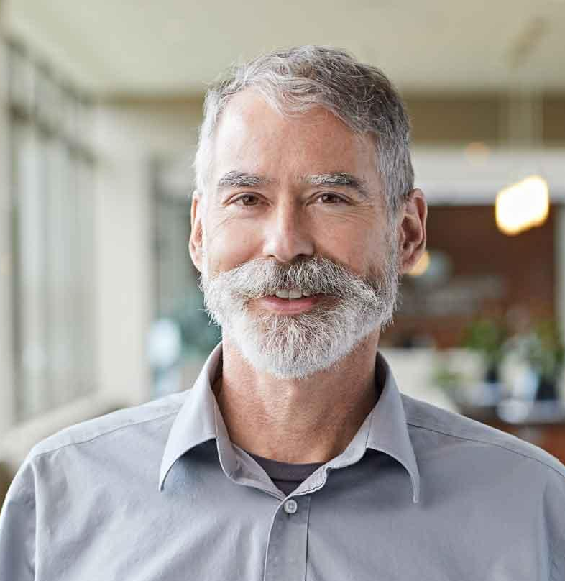

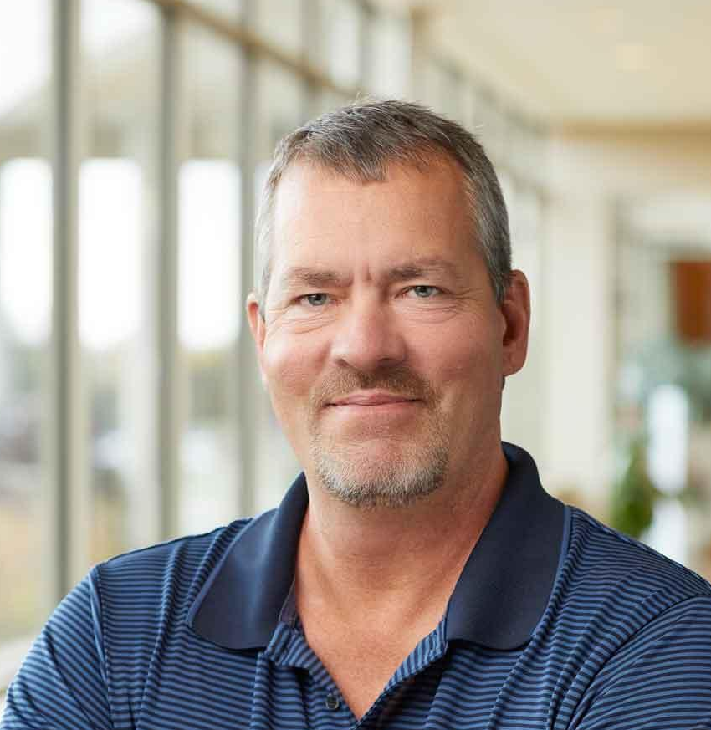

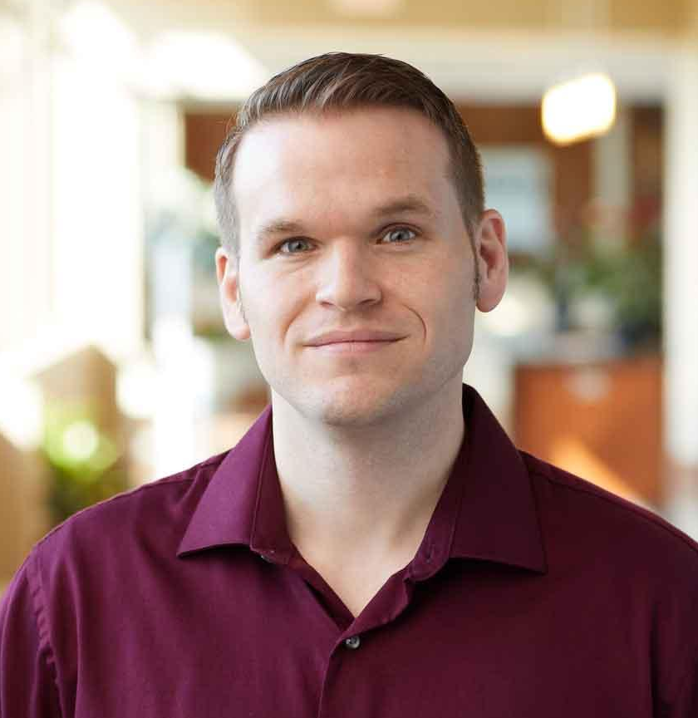
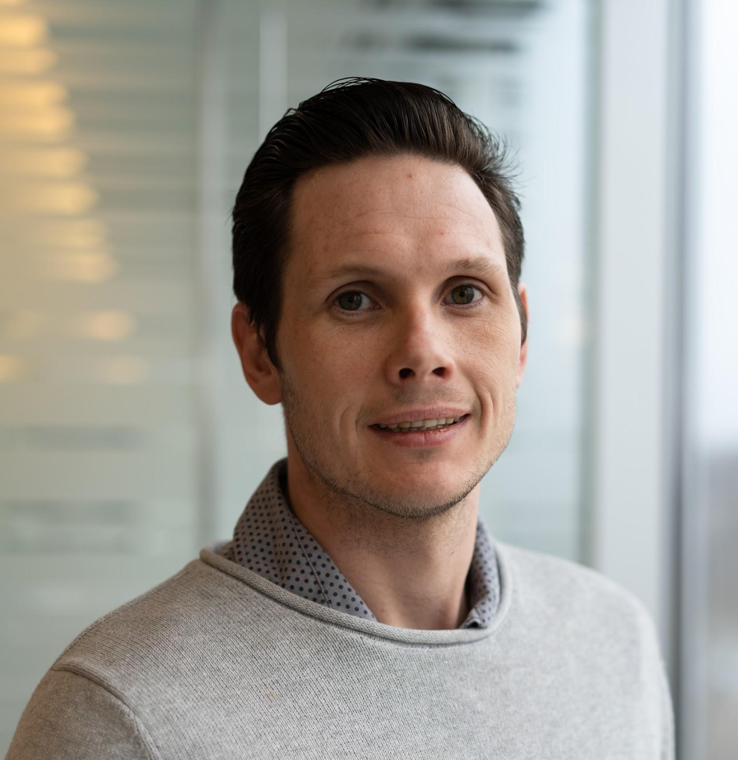
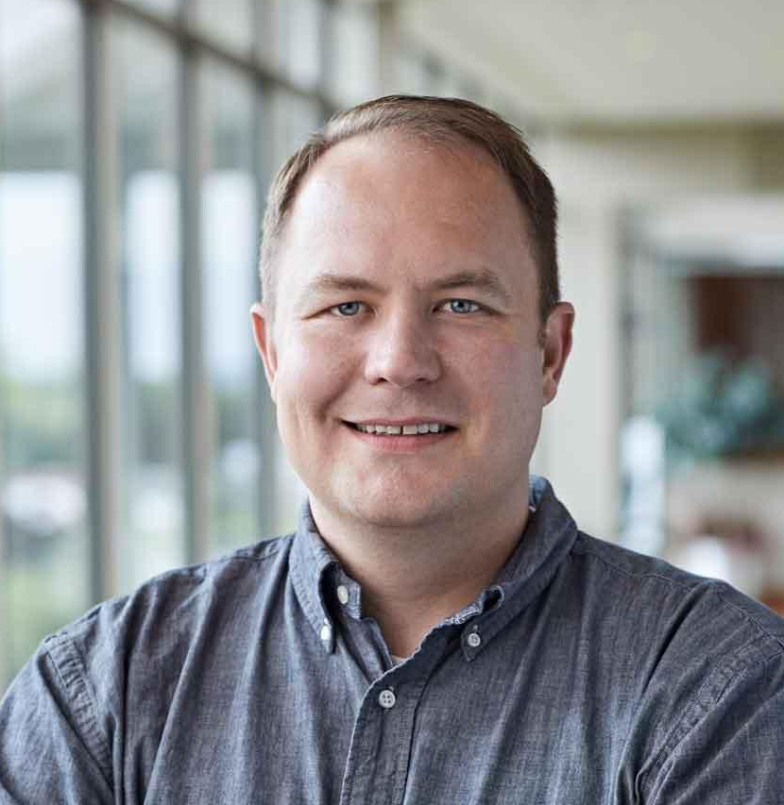

Lewis County’s Design, Construction & CX Team
Leigh Myers, PE
Engineering
Christian Garcia, EIT
Engineering
Deryl Sarver,
Construction
Dan Nguyen, PE
Engineering
Josh Slocum, PE
Controls & Commissioning
Jon Howard, PE
Engineering
Justin Pape,
Construction
Notes:
Not here today is the rest of our team of talented professional engineers, construction managers, estimators, controls and commissioning agents, etc who have been working for almost a year to develop the plans and designs for these complex retrofit projects. We have Leigh Myers, Christian Garcia, Jon Howard (Mechanical PEs), Dan Nguyen (Electrical PE), Josh Slocum (CX & Controls), Deryl Sarver (Senior CM), & Justin Pape (estimator).

Slide 5
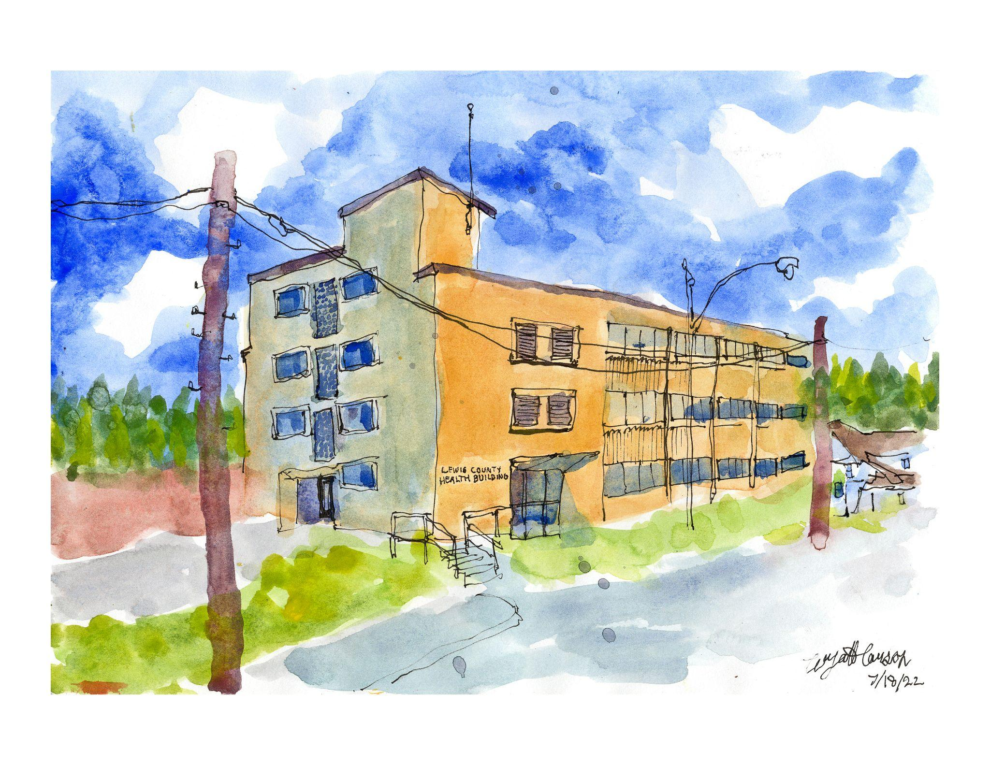
Project Background
2018-2019 Lewis Co vetted firms for Jail project
Millig was contracted in August 2021
The project is using the Department of Enterprise Services (DES) via an Inter Agency Agreement
DES acts as owner’s rep for Energy Services Performance Contracting program (ESPC)
Notes:
Between 2018 and 2019, Lewis County vetted three firms to provide turnkey services to upgrade the end of life systems at the Jail building. (Then we had a little COVID break.) The County selected Millig Design Build and we got under contract in August 2021 to design and develop the upgrades. There was delay for a few months in there, when the previous Facilities Director left and was replaced by John Clark (who is really great, by the way), but we have even still, we have remained on target for a fall 2022 construction project.
Lewis County engaged Millig Design Build through the Department of Enterprise Services ESPC program. That means that Lewis Co has an interagency agreement with DES; DES provides a PM and owner’s rep services to the county throughout the project. I.e. DES oversees us and protects the interest of the County.
The effort has focused on the two highest priority facilities for the county, the Jail and the Health Building.

Slide 6
Project Goals
Renew critical County facilities for the long term with practical, fiscally-responsible system upgrades.
Jail Building:
  Replace Failing and End-of-Life HVAC Equipment
  Replace Failing and Obsolete Building Automation Controls
  Replace Leaking and End-of-Life Roofing System
  Reduce Facility Energy Use to Meet Clean Building’s Act Requirements
Health Building:
  Add Ventilation and Cooling
  Improve Comfort
  Replace Leaking Windows
All Projects:
  Pursue All Possible Grants and Incentives to Minimize First Costs
  Reduce Energy and Maintenance Costs while Improving System Reliability

Slide 7
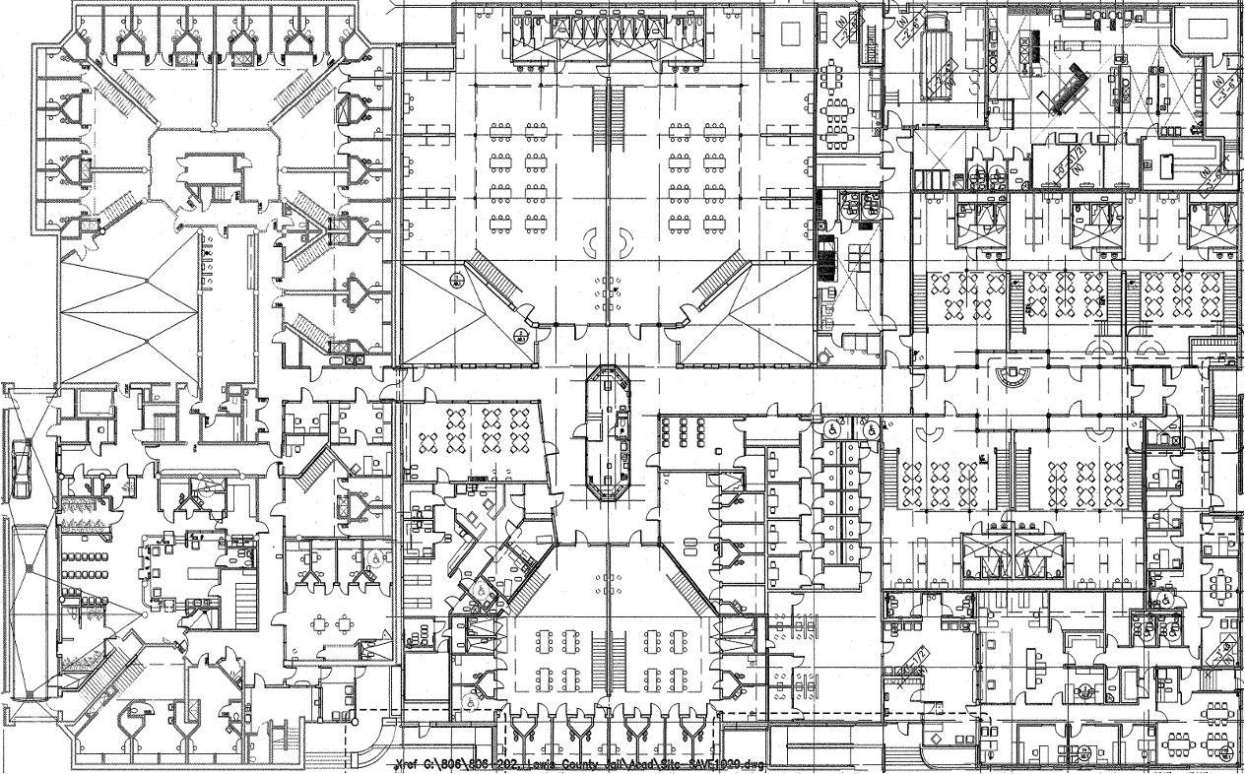

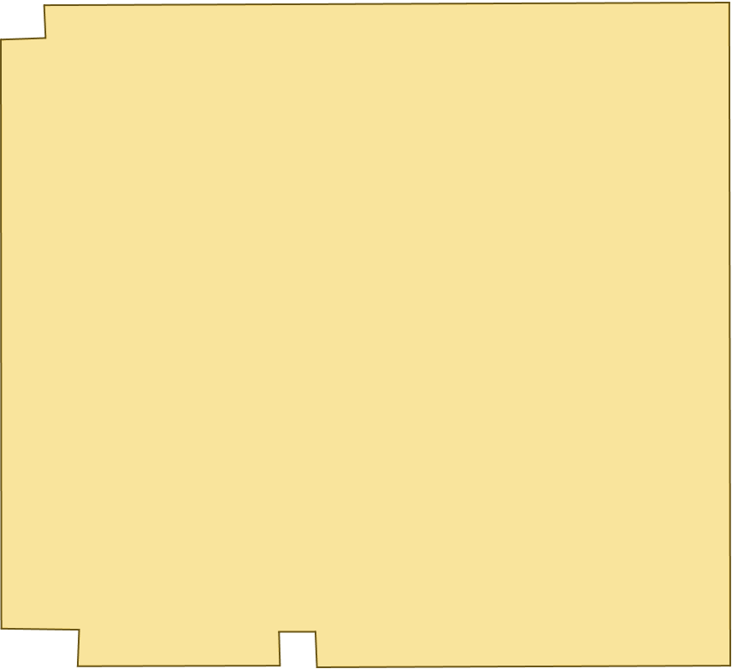
Facility Overview - Jail
Original 1985 Jail
2005 Jail Expansion
Notes:
The Lewis County Jail is a 90K sqft 2-story facility with two construction eras. The original Jail (or Old Jail) section was constructed in 1985, In 2005, a 60K SF addition was constructed on the southern side (New Jail) and the 1985 portion of the facility was renovated.
The facilities mechanical and controls systems are nearing 20 years old - which would be considered end of life in any facility, but is particularly striking for a Jail, given that it operates 24/7/365. A 20 year old rooftop unit on a school would be at end of life, and it only operates about 2,500 hours per year. Your systems operate 8760 hours per year and many of the systems have reached or passed the point of imminent failure.
It’s really a testament to your fantastic facilities staff including Gary who just retired, that these system are still operational. But even the best efforts can only prolong the inevitable and you have certainly gotten a great deal of use out of your existing systems.

Slide 8
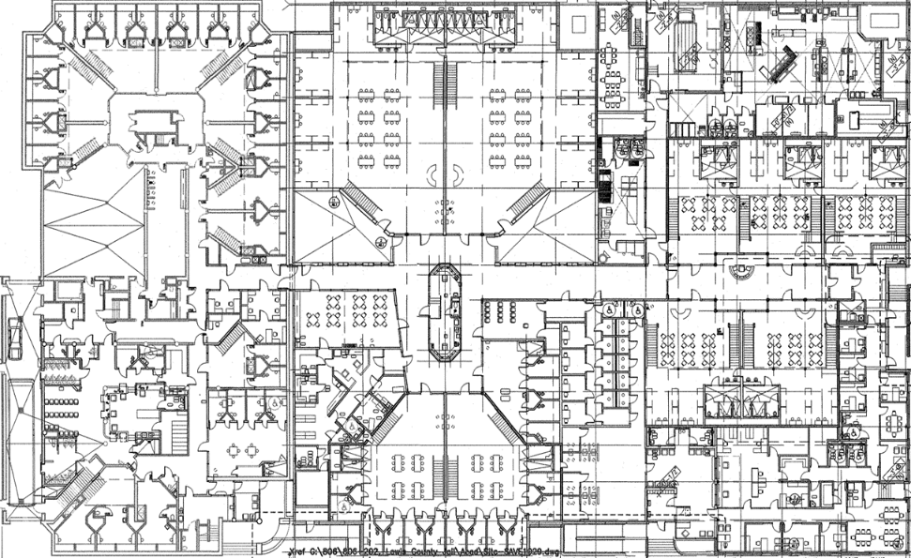
VAV AHU
AHU-1
Gas/DX w/ HW Reheat
Heat Recovery Wheel
15,800 cfm
Laundry Make Up Air
MAU-2
Gas/Evap Cooling
100% OSA
2,665 cfm
VAV AHU
AHU-10
Gas/DX w/ HW Reheat
Heat Recovery Wheel
1,600 cfm SAF
Jail HVAC Floor 1
Kitchen Make Up Air
MAU-1
Gas/Evap Cooling
100% OA
8,350 cfm
VAV AHU
RTU-1
Natural Gas /DX
Heat Recovery Wheel
100% OSA
19,000 cfm
VAV AHU
AHU-9
Gas/DX w/ HW Reheat
Heat Recovery Wheel
7,950 cfm
Ductless A/C unit
AC-1
5 kW electric reheat coil
DX cooling coil
VAV AHU
AHU-3
Gas/DX w/ HW Reheat
Heat Recovery Wheel
5,790 cfm
Constant Volume AHU
AHU-4
Installed 2002
Provides OSA to control room
10 kW electric heat
No cooling
VAV AHU
AHU-7
Gas/DX w/ HW Reheat
Heat Recovery Wheel
7,070 cfm
VAV AHU
AHU-8
Gas/DX w/ HW Reheat
Heat Recovery Wheel
5,790 cfm
Comp. Room A/C Unit
CRAC-1
DX/Electric reheat
Humidifier
895 cfm SAF
Cabinet Unit Heater
CUH-3
Hot water coil
VAV AHU
AHU-5
Gas/DX w/ HW Reheat
Heat Recovery Wheel
2,530 cfm
VAV AHU
AHU-2
Gas/DX w/ HW Reheat
Heat Recovery Wheel
6,700 cfm
VAV AHU
AHU-6
Gas/DX w/ HW Reheat
Heat Recovery Wheel
2,440 cfm
Cabinet Unit Heater
CUH-1, 2
Hot water coil
Notes:
I am not going to go through the HVAC systems in detail, but I wanted to include these to show that this is a large building, with a lot of different air handlers and systems. There are 12 large air handling units on the roof of the 2005 section that are in dire need of replacement, and the HVAC in the 1985 section is need of major modifications. Our approach has been to devote significant extra effort to avoid 1-for-1 replacement, and instead, redesign and select new units and systems to maximize energy efficiency and minimize ongoing energy and maintenance costs for the next 20 years.

Slide 9
Jail Building - Major Deficiencies
Air Side HVAC
Roof
Air handlers are at end of life and experiencing frequent failures. 100% OSA system serving 1985 section needs upgrades.
Chronic roof leaks require significant County staff time and resources. Core samples showed moisture damage under the membrane on the 1985 section.
Building Automation Controls
Domestic Water Piping & Inefficient Lighting
Controls system is obsolete and unsupported. It is too old to find replacement parts. It is difficult to use and its capabilities are very limited. Same obsolete controls operate smoke purge system in the event of a fire.
Chronic domestic water leaks, especially in 1985 section.
Lighting is inefficient T8s with ballasts. High energy use and maintenance costs.
Facilities department estimates it spends $200,000+ annually
on break/fix maintenance projects at the Jail.

Slide 10
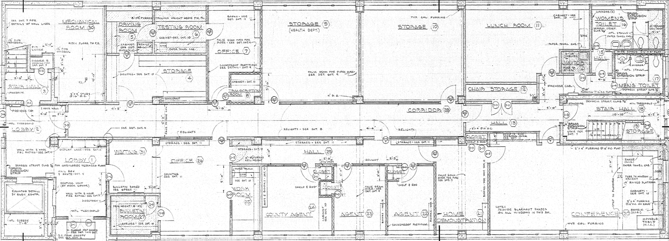
Facility Overview - Health Building
Boiler Plant
Low efficiency atmospheric boiler
No redundancy
Hot Water Radiators
Perimeter heat only
Window AC Units
Major Deficiencies
No ventilation. No central cooling. No controls.
Does not meet code. Comfort issues. Excessive energy use. Asbestos.
Notes:
The Lewis County Department of Health Building is a 18K sqft 3-story facility constructed in 1953. Some renovations and remodels have occurred over the years, including new LED lighting and a new roof in the last few years. Low efficiency atmospheric boiler. Perimeter radiator and window ac units in office.
The building has no mechanical ventilation, no central cooling, and only perimeter radiator heat supplied by an inefficient atmospheric boiler. The existing windows are leaking water which is leading to water damage, they are also drafty and lead to comfort issues.
The major engineering challenge of this building is that the floor to floor height is unusually restricted. There are 8 foot ceilings, and only 14 inches above the lay in ceilings and 6 inches above the hallway. There is asbestos tiles and mastic

Slide 11
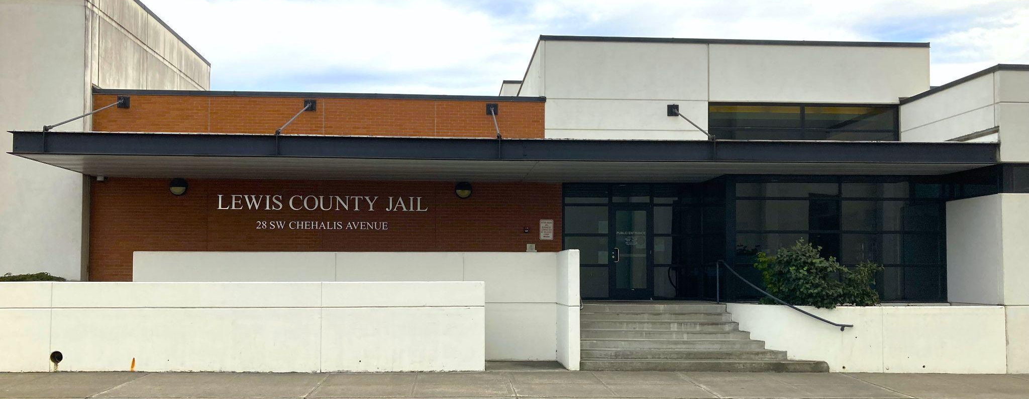
Jail Bldg Scope of Work

Slide 12
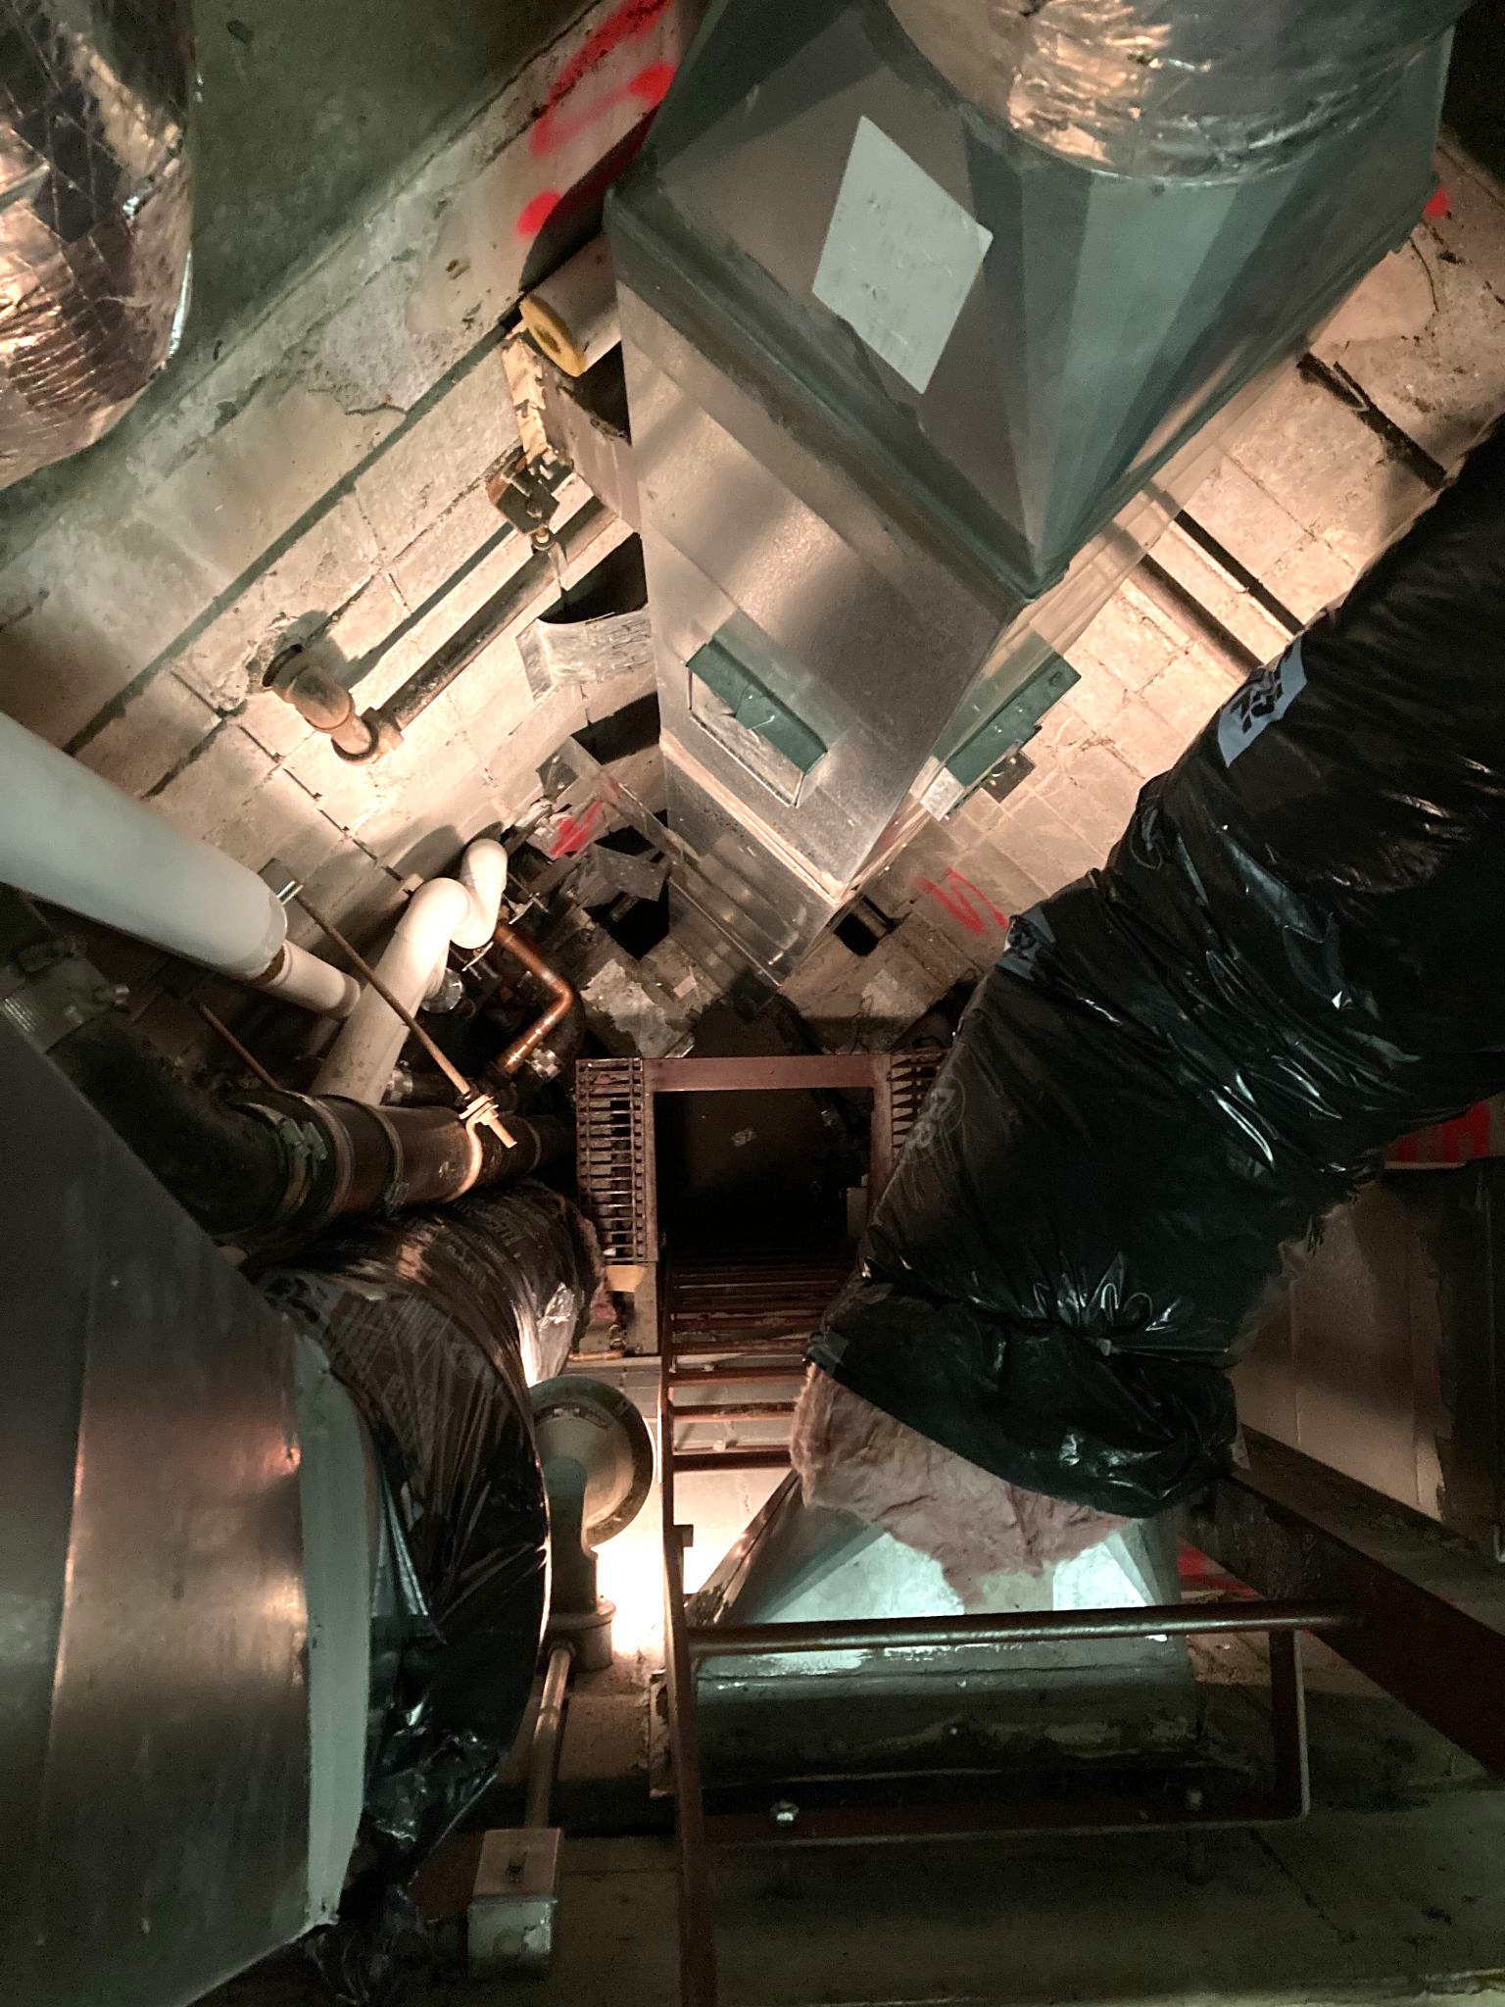
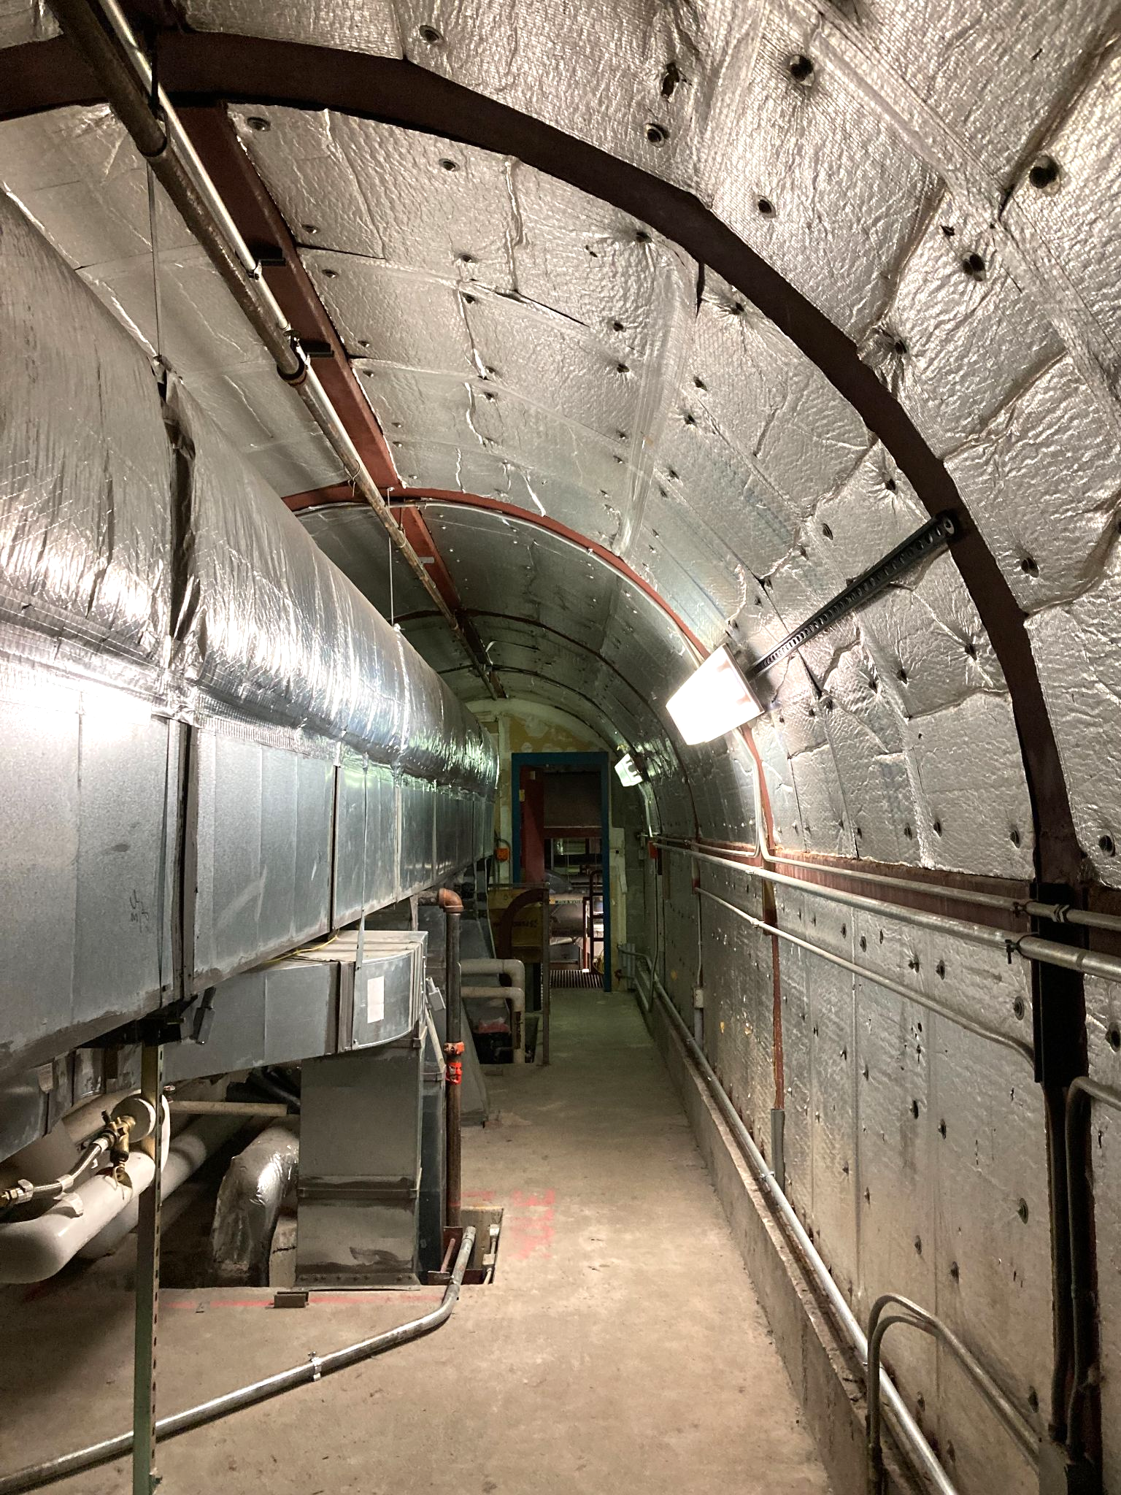
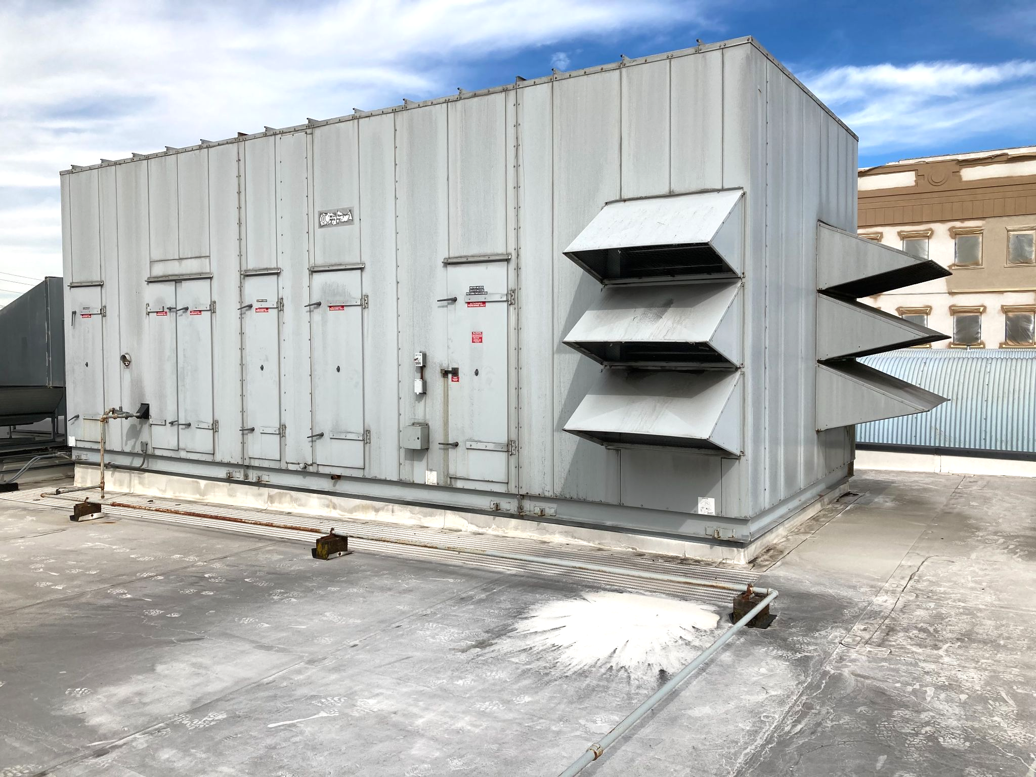
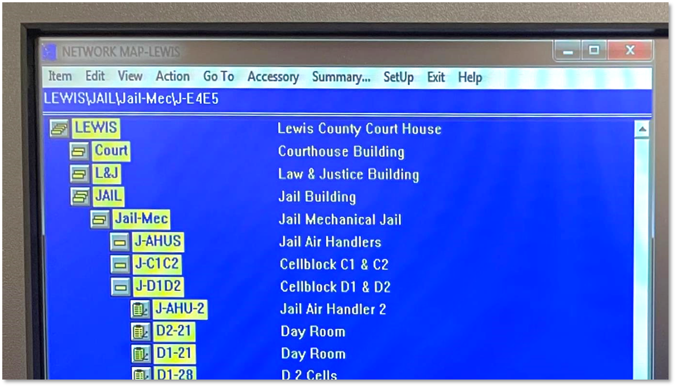
Jail Building HVAC & Controls Scope
1985 Old Jail
Redesign and replace existing HVAC system with highly efficient new variable refrigerant flow (VRF).
Rebuild RTU 1 with new heat recovery wheel and lower airflow; utilize rebuilt unit for ventilation air for VRF fan coils. Reuse existing ductwork.
Take boiler offline.
New controls system throughout.

Slide 13
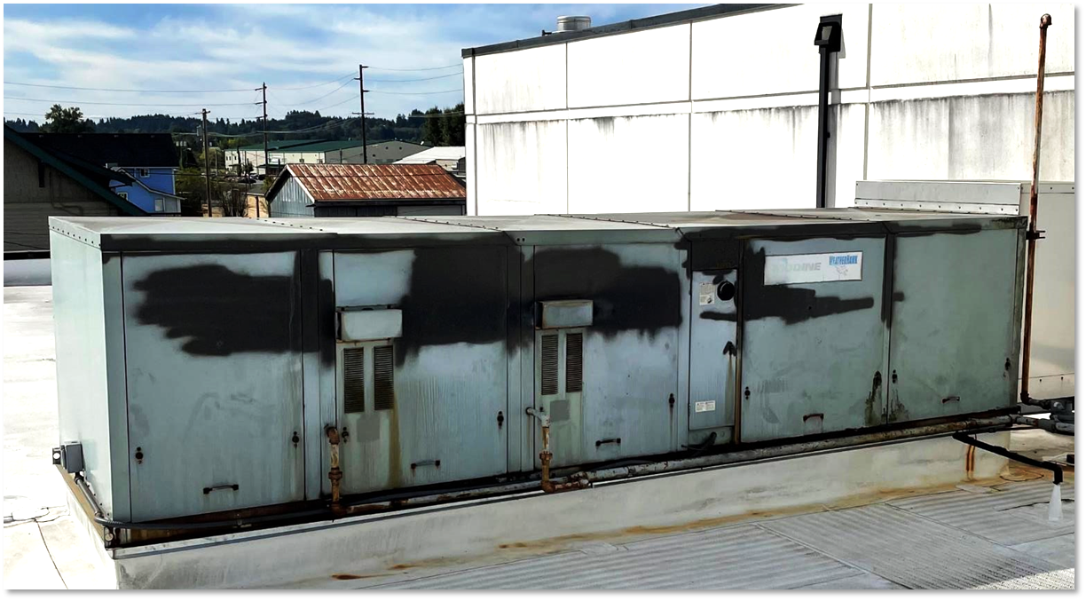
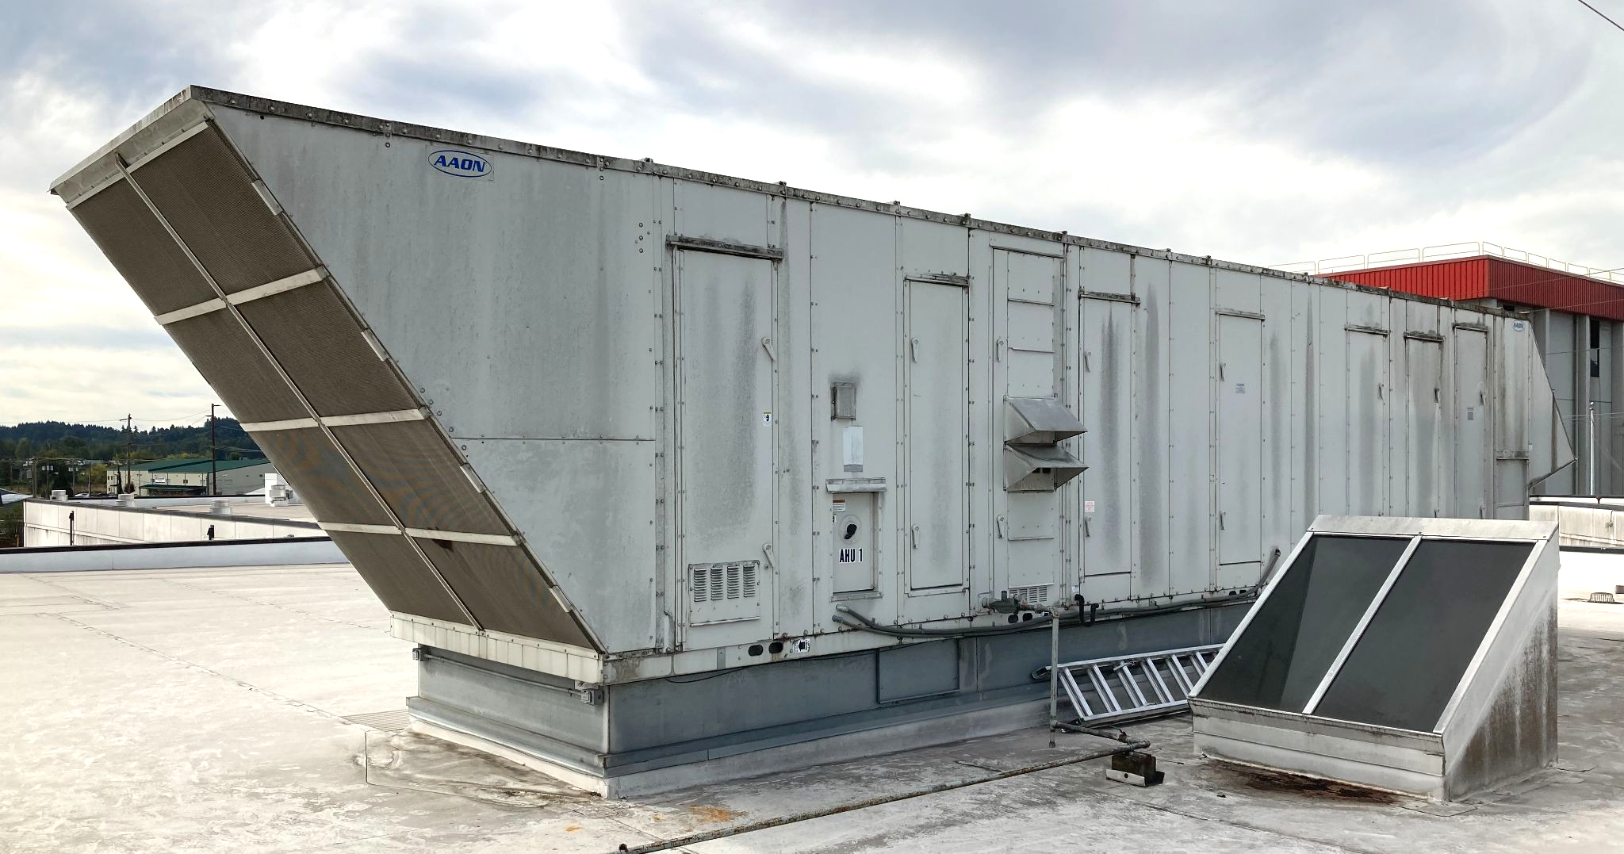
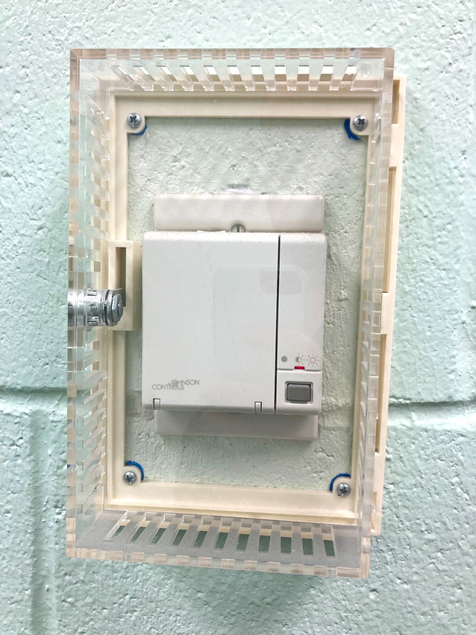
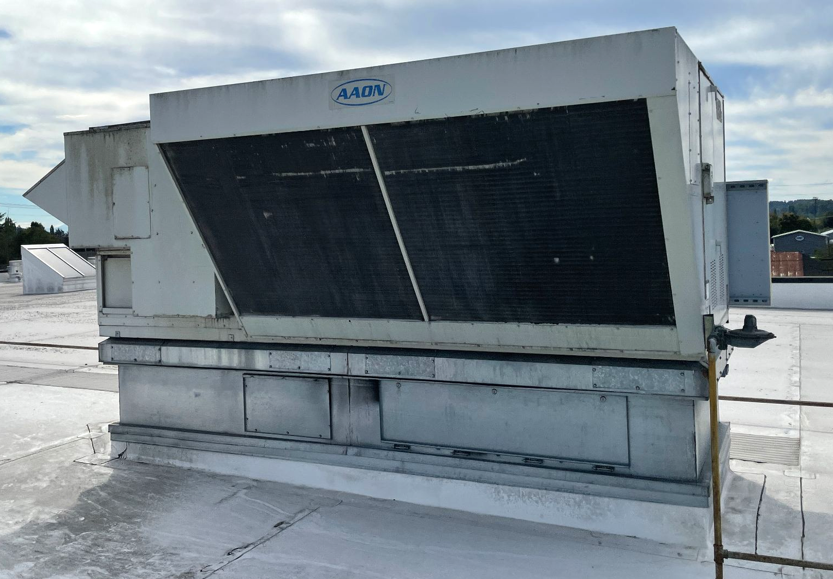
Jail Building HVAC & Controls Scope
2005 New Jail
Redesign and replace 10 Aaon rooftop units with new high efficiency units. Optimize outside air levels and airflows to downsize units. Reuse existing terminal units and ductwork.
New controls system throughout.
Install two new high makeup air units for the Kitchen and Laundry to meet cooling loads. Utilize demand controlled ventilation in Kitchen MAU.

Slide 14
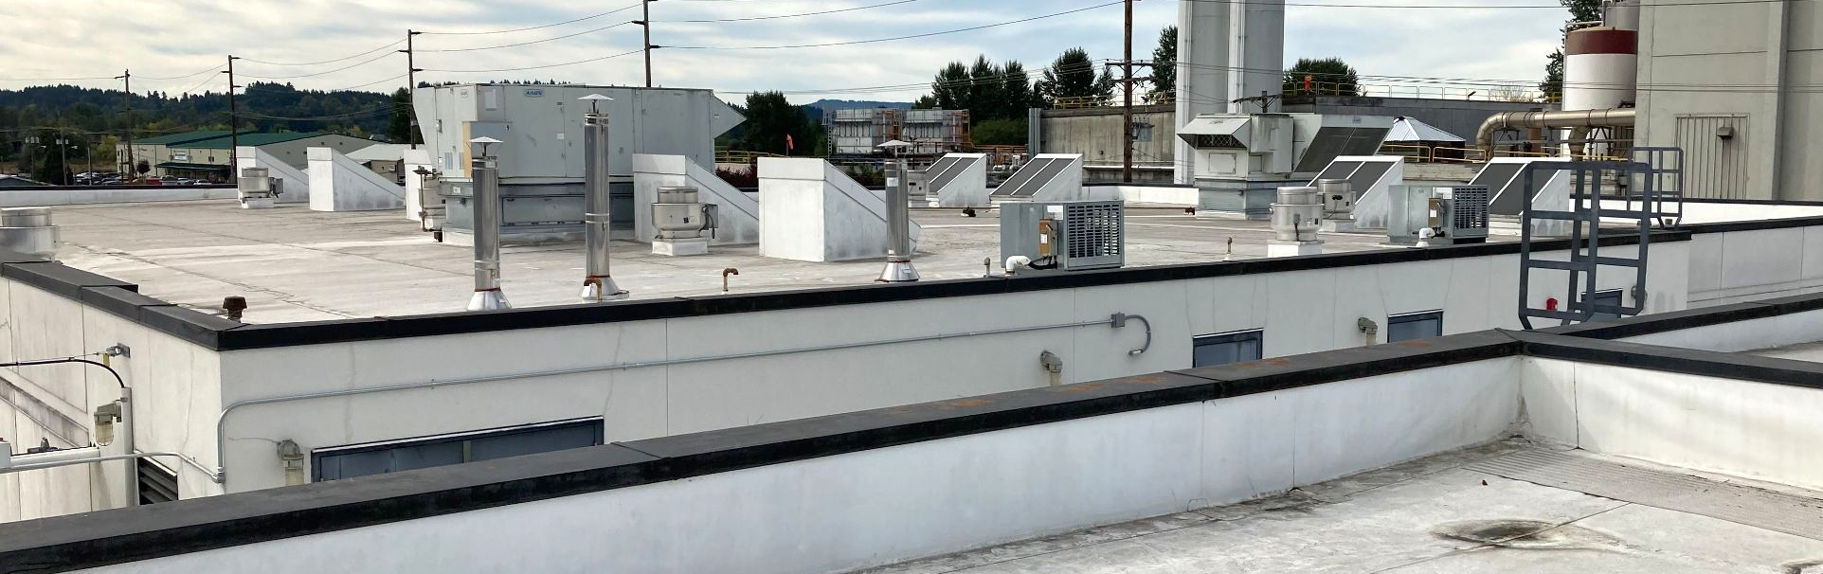
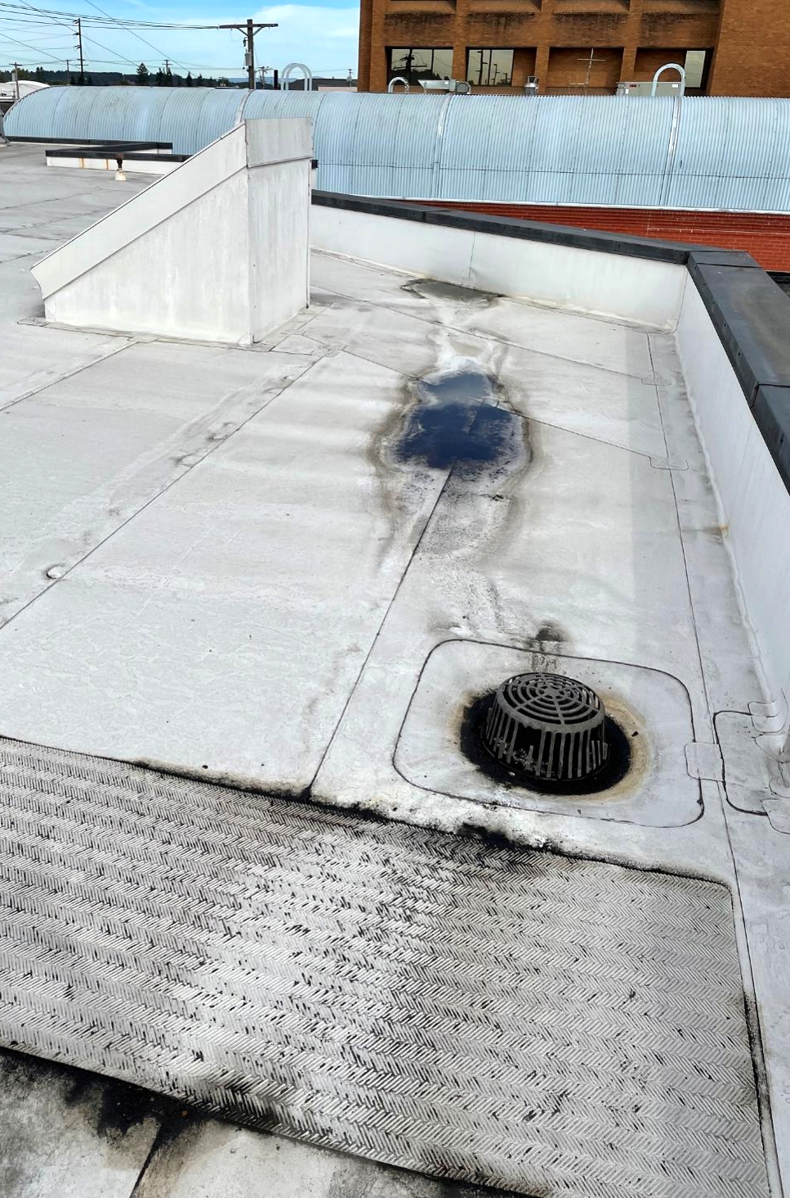
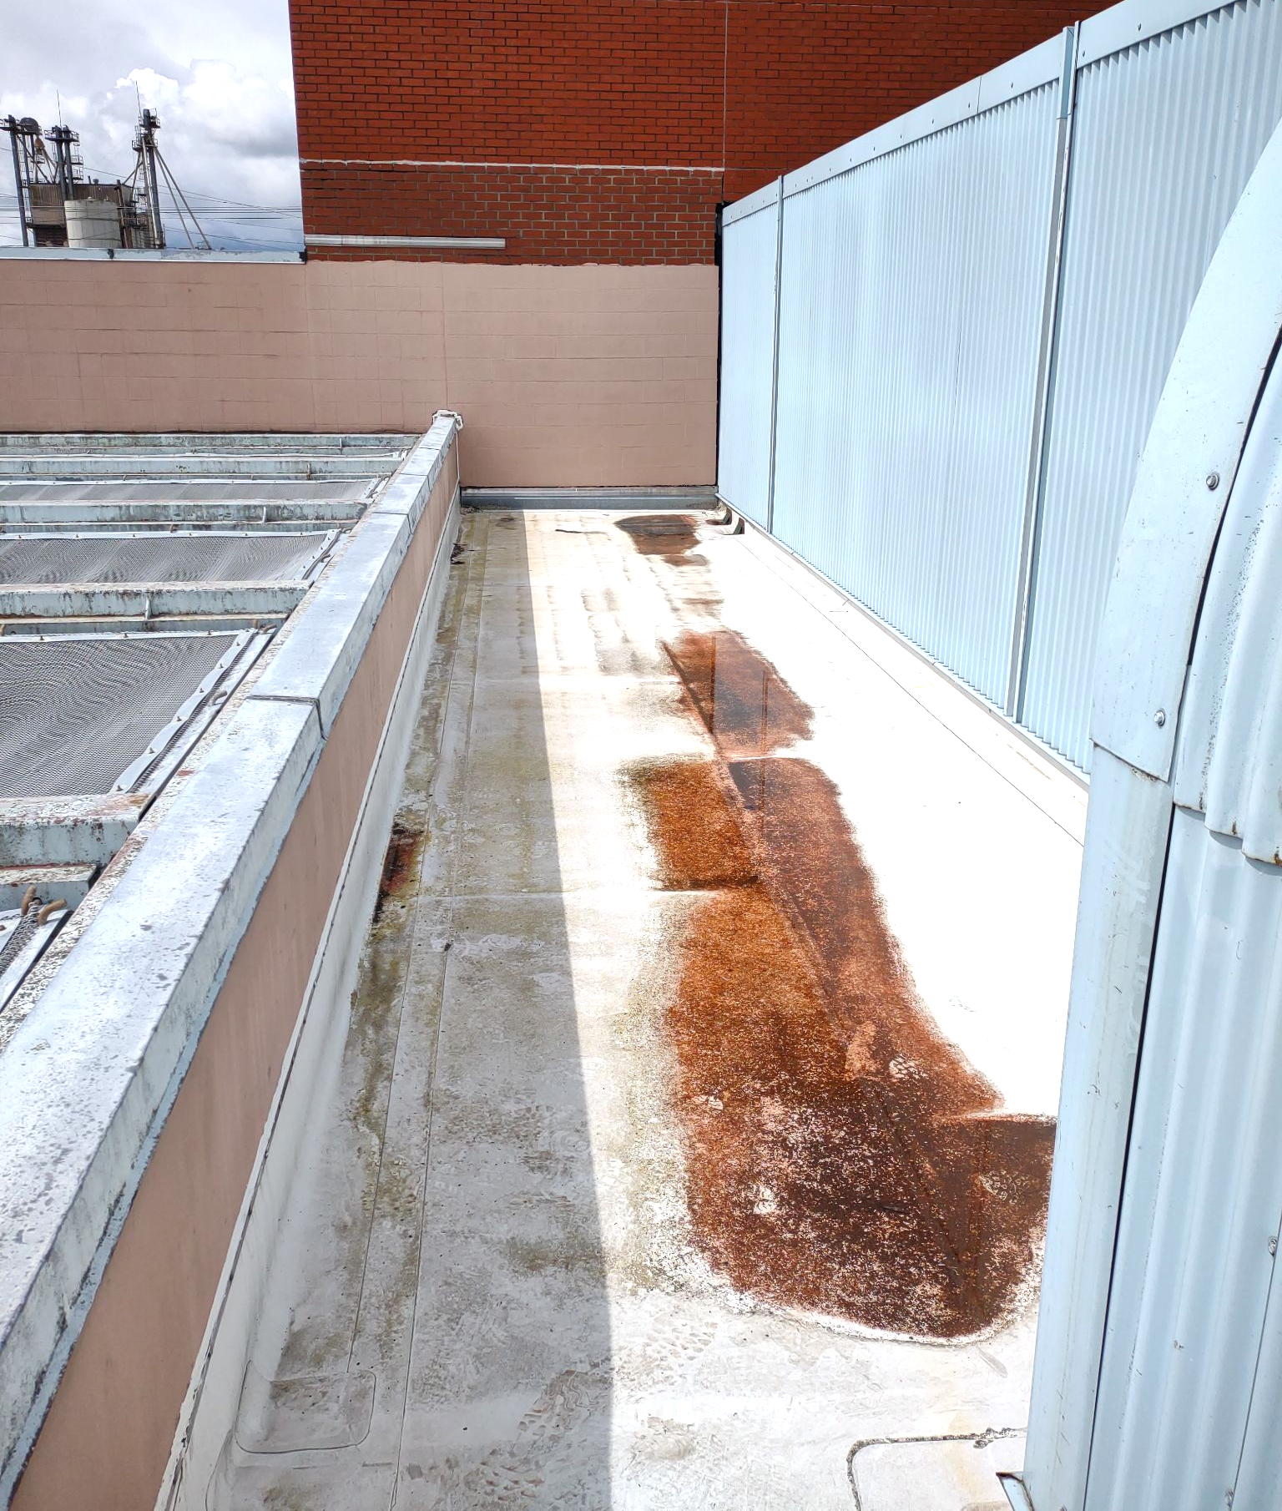
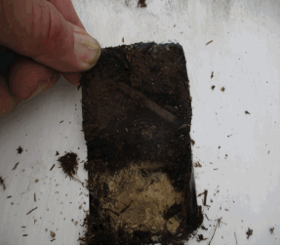
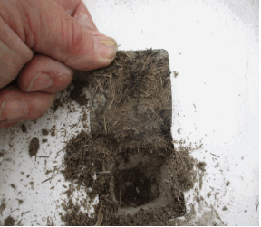
Jail Building Roof Scope
Entire Roof Area
Repair or replacement of TPO membrane.
Install flashing and waterproofing around new RTUs and other rooftop equipment.
Avoid costly upgrade from R-34 to R-38 by asking code officials for variance.
1985 Old Jail
Replace water damaged cover board. Lightweight concrete to remain.

Slide 15
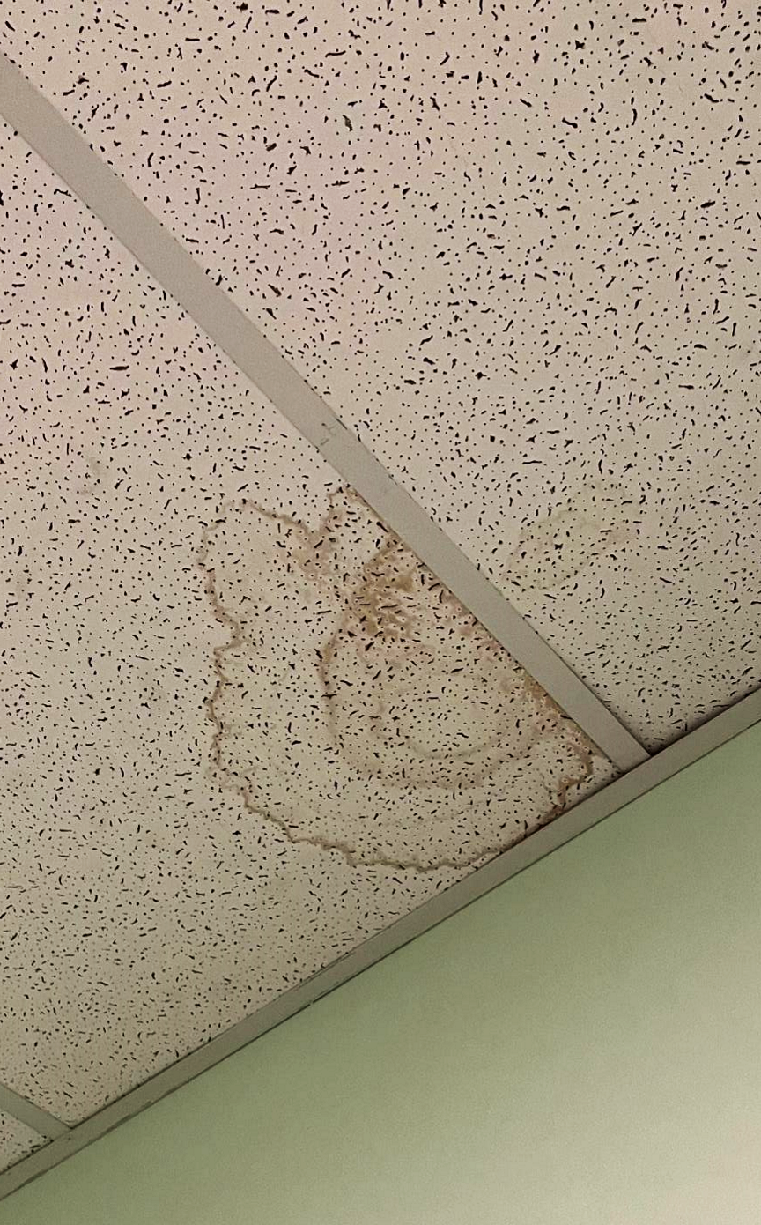
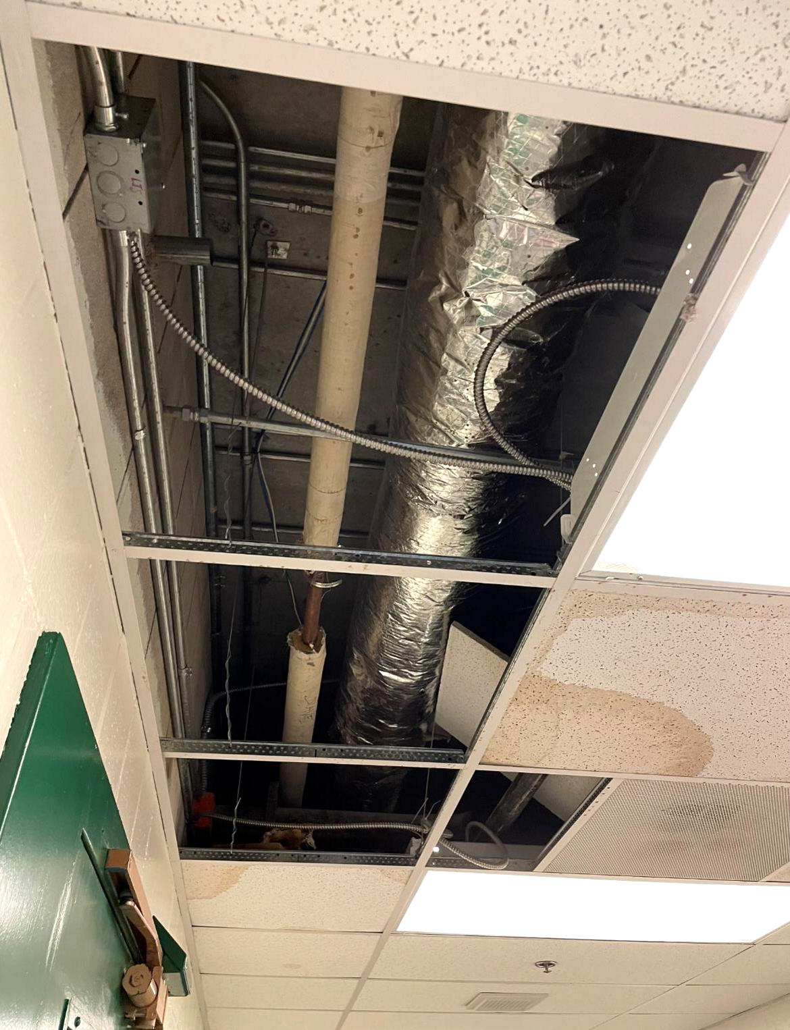
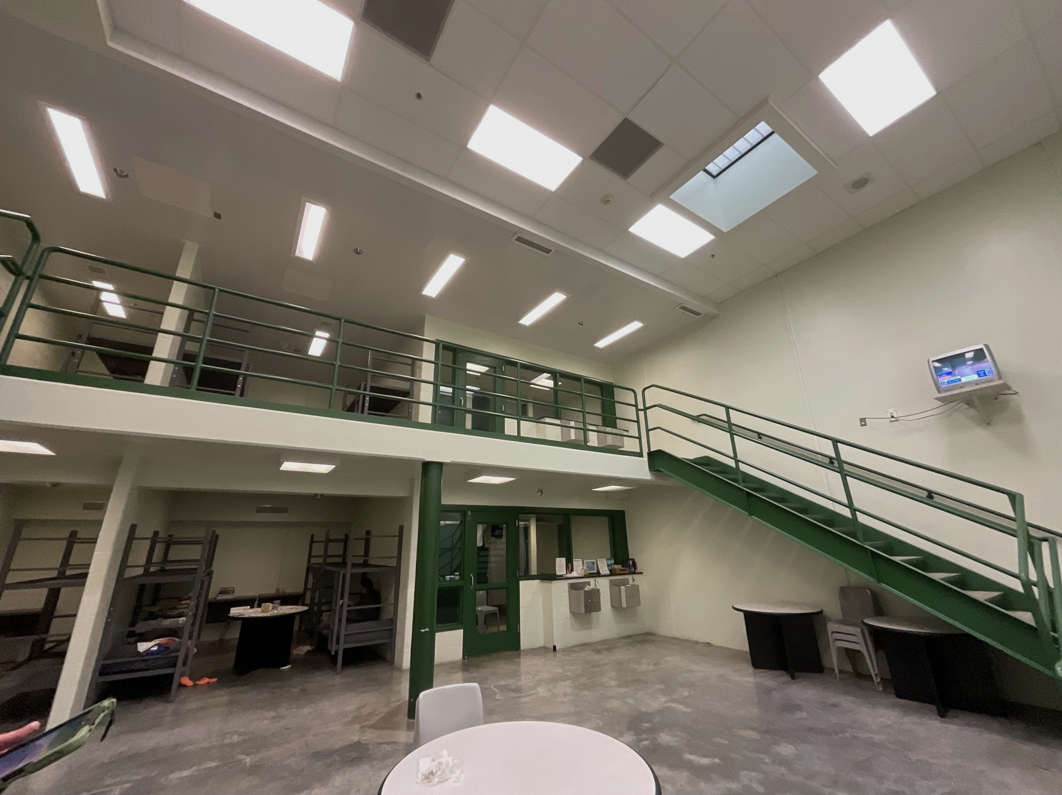
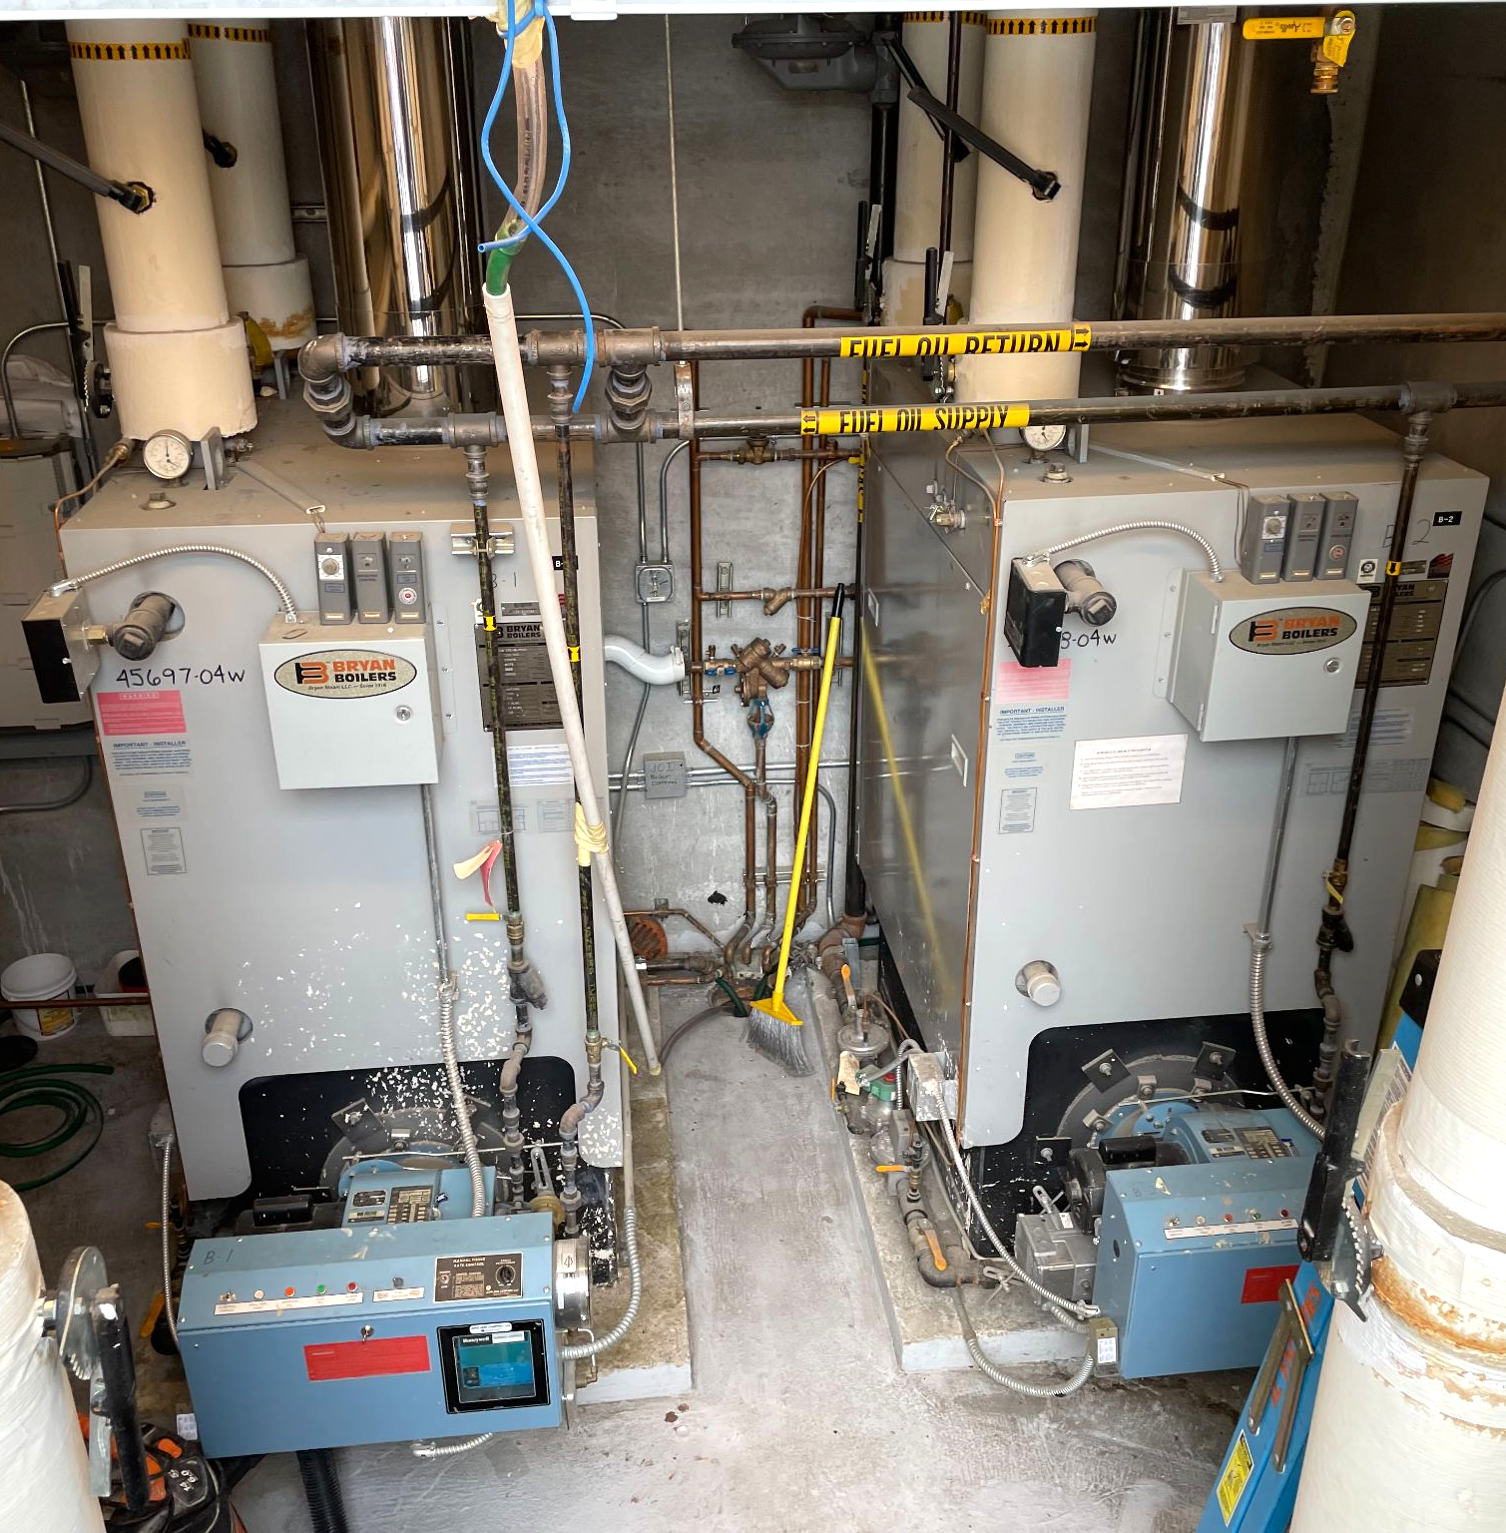
Jail Building Boiler, DHW, & Lighting Scope
1985 Old Jail Domestic Hot Water Piping
Replace domestic hot water mains in 1985 section to prevent frequent and persistent leaks.
2005 New Jail Heating Water Boiler
Replace one standard efficiency boiler with full condensing for energy efficiency.
Entire Jail
Upgrade high maintenance and inefficient lighting with LED throughout.

Slide 16
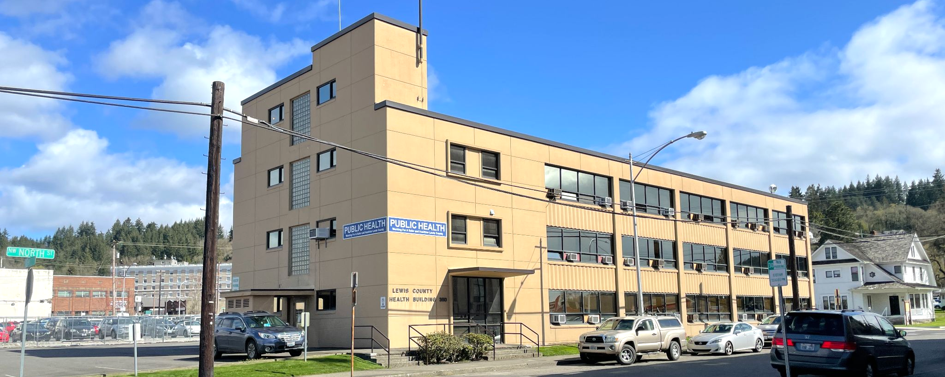
Health Building Scope of Work

Slide 17
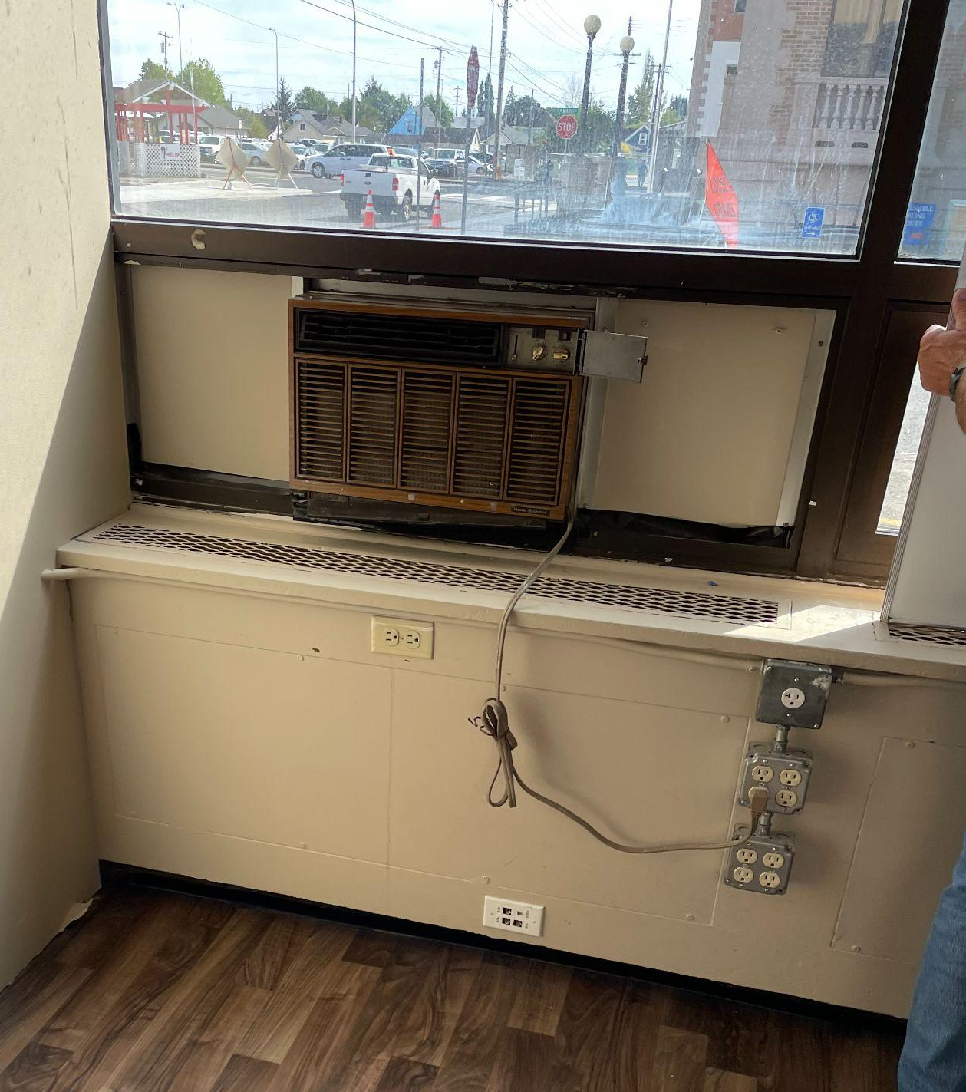
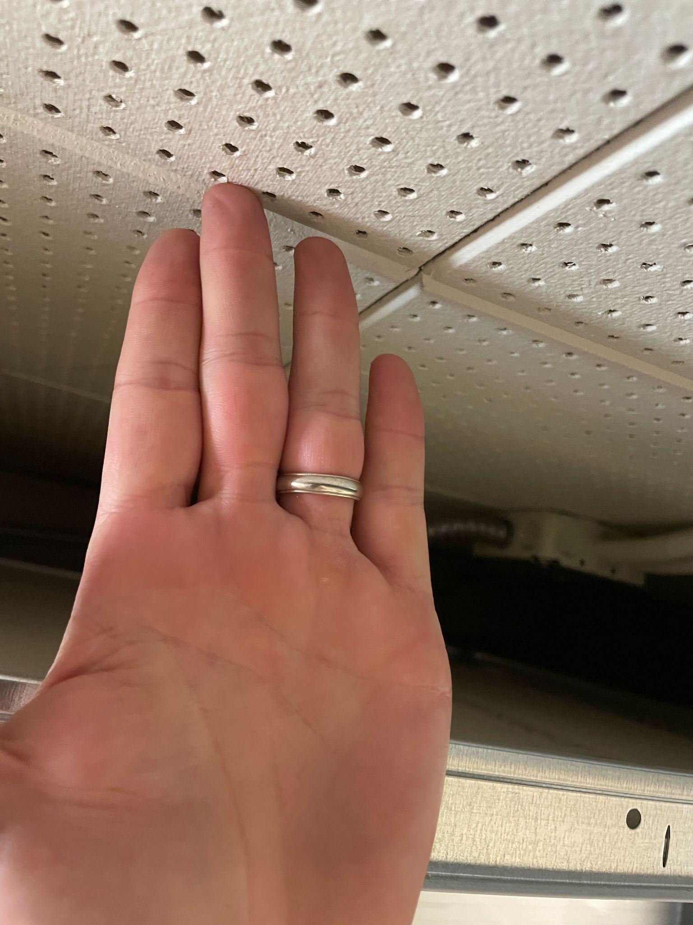
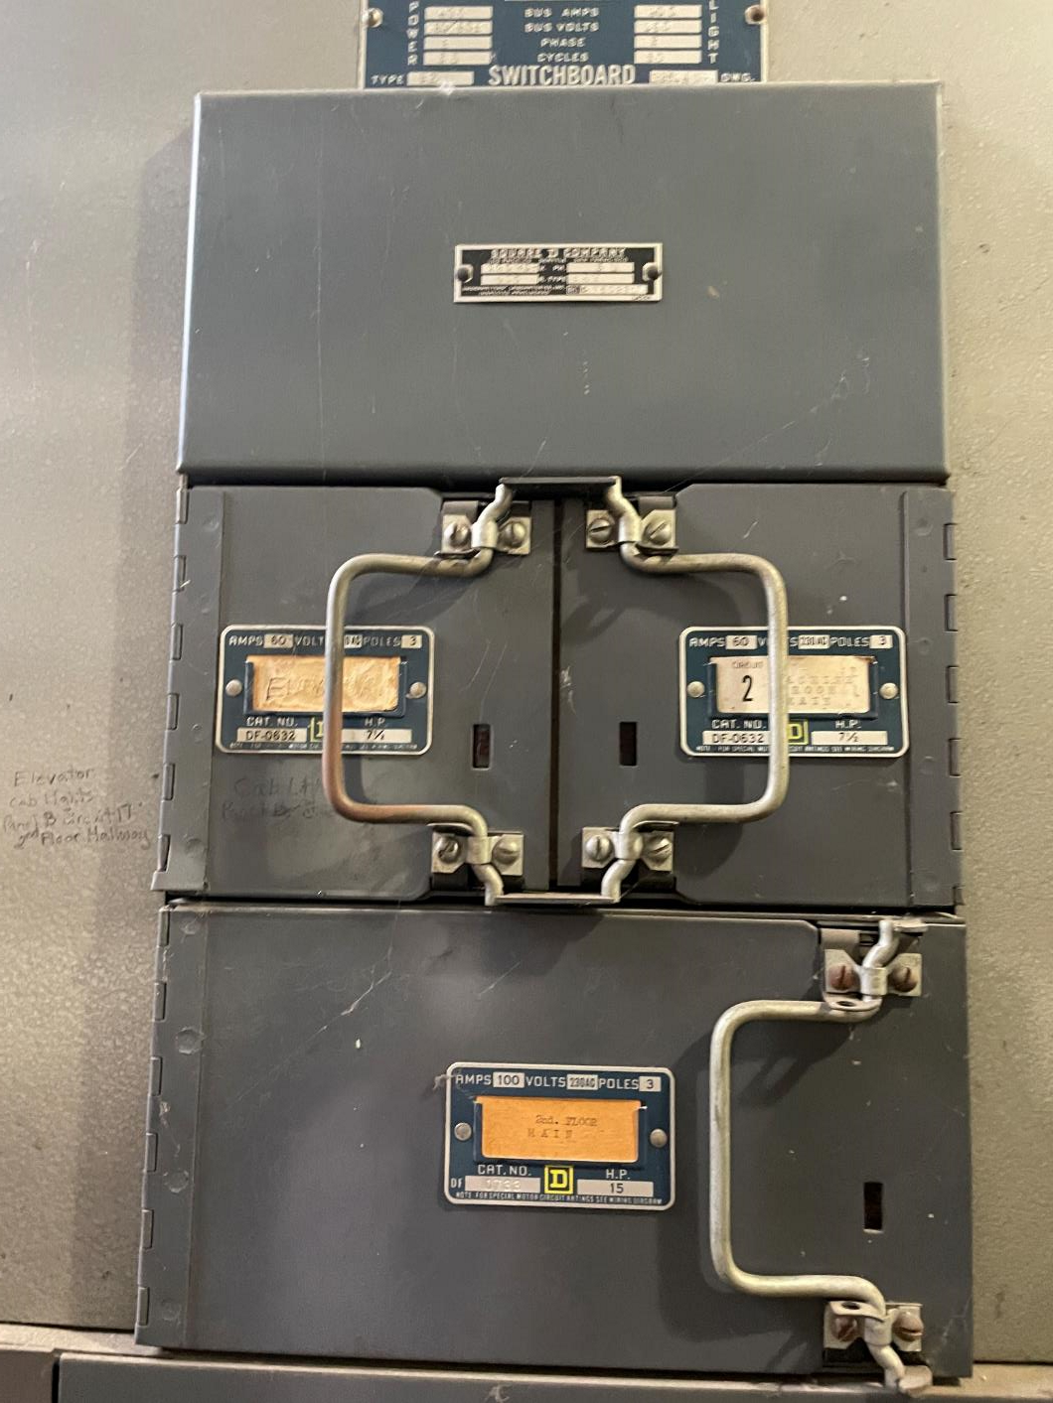
Health Building Scope of Work
HVAC Scope
Redesign and replace existing HVAC system with highly efficient new variable refrigerant flow (VRF).
Install energy recovery ventilators and all new ductwork to supply ventilation air to all VRF fan coils.
Take boiler offline.
New controls system throughout.
Windows Scope
Replace leaking windows with new double pane, thermally broken windows installed with proper sill flashing and end dams.
Remove window AC units and panels, and upgrade to single section windows for a cleaner building appearance.

Slide 18
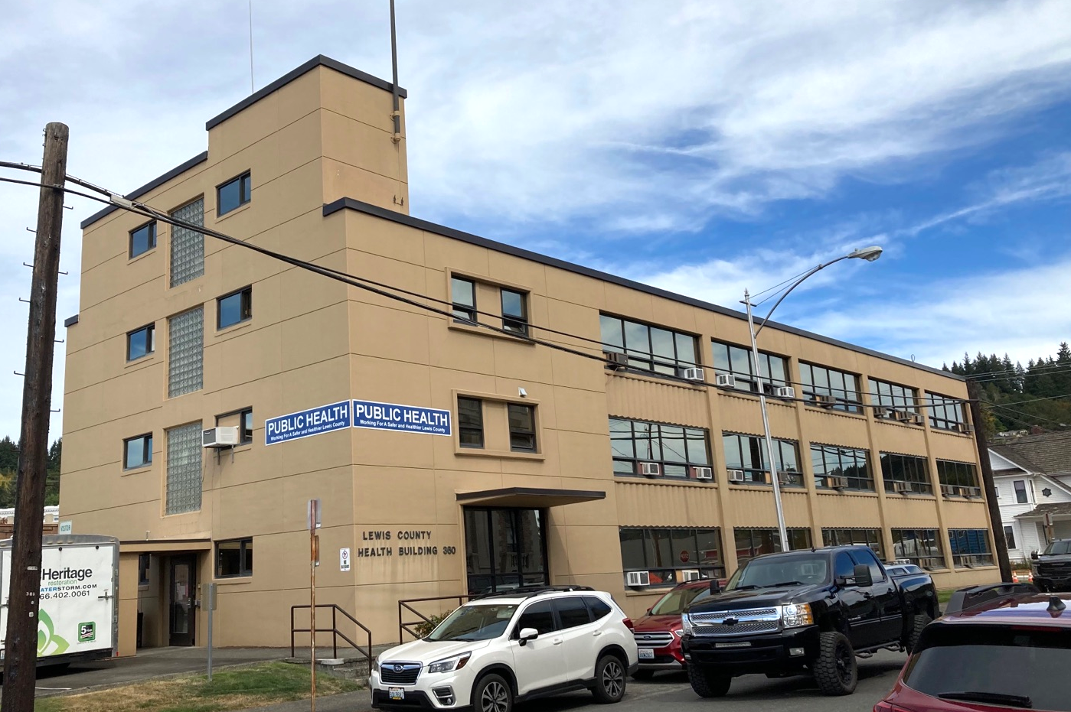

South Elevation - Before and After
Before After

Slide 19
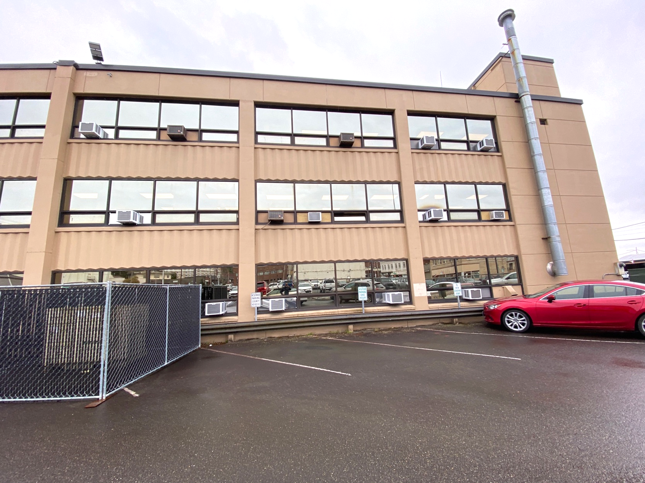
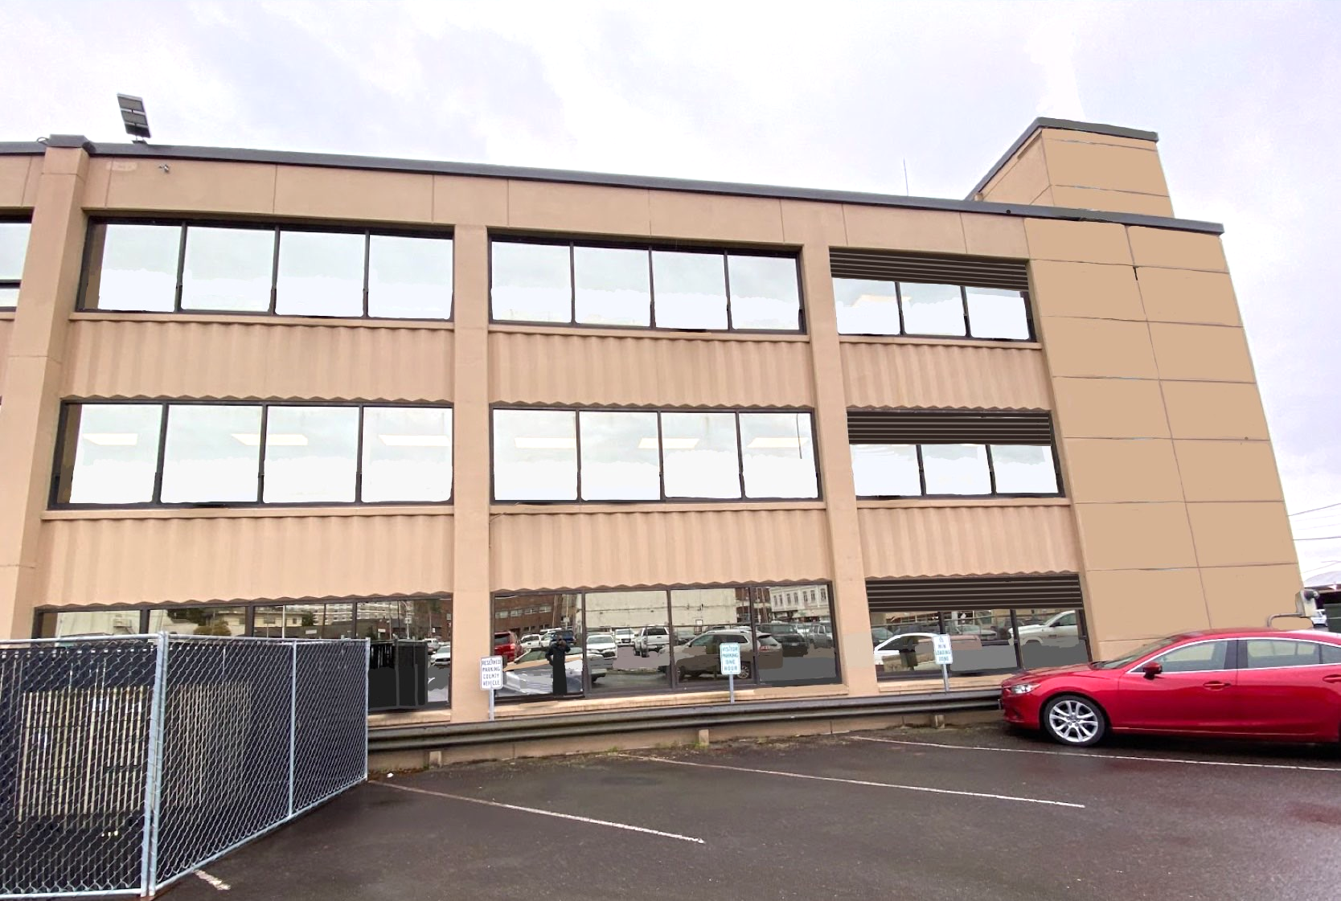
North Elevation - Before and After
Before After

Slide 20
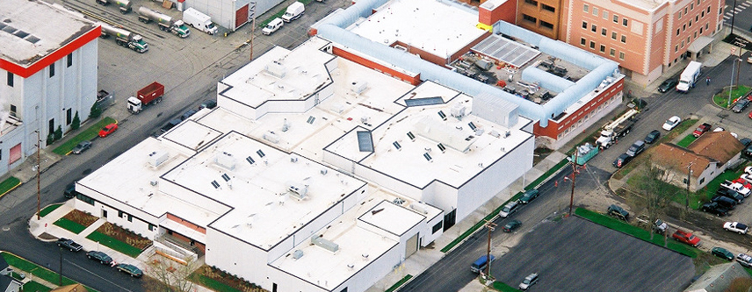
Project Financials

Slide 21
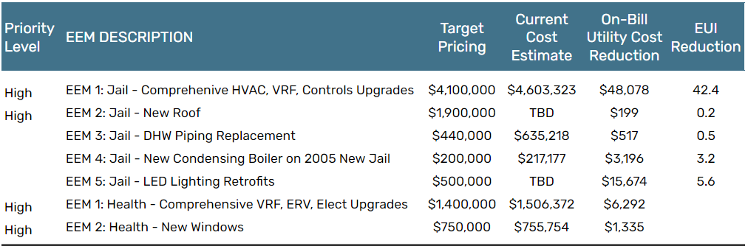

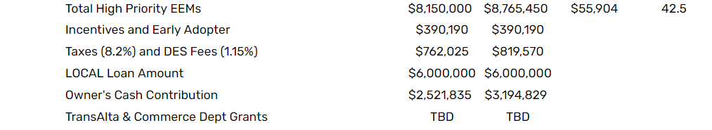
Project Financials

Slide 22
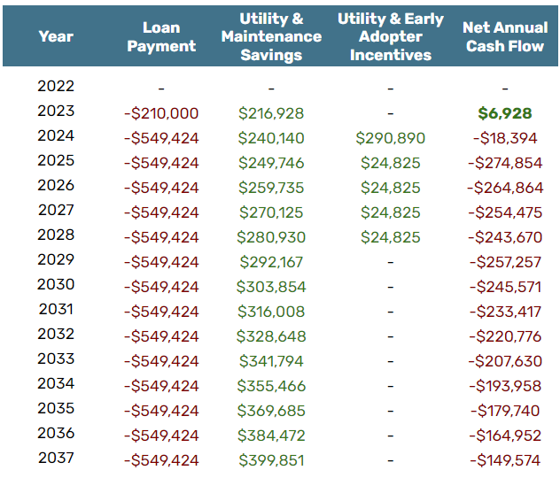
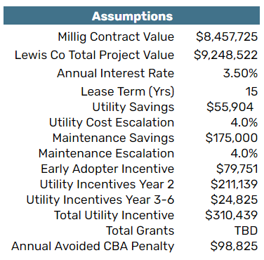
LOCAL Loan Financing Scenario

Slide 23

Questions?
Lauren Donley, CEM, CBCP
541-390-2467
ldonley@milligdb.com

