Slide 1





Lewis County
2023 Preliminary budget review
November 22, 2022
BOARD OF COUNTY COMMISSIONERS
Dr. Lindsey R. Pollock, DVM, Chair
Sean Swope, Vice Chair
F. Lee Grose, Commissioner
Erik Martin, County Manager
Becky Butler, Budget Administrator
Rieva Lester, Clerk of the Board
Notes:
The presentation tonight is on the Preliminary Budget numbers and an overview of changes that have been approved for the Final budget.

Slide 2
Citizens Budget Committee
Statement of purpose of the Committee:
Represent the best interests of the entire county while acting as a bridge for communication between the Commissioners and local residents and businesses.
Benefits of the Citizens Budget Committee:
  Better communication with Lewis County Residents
  Outside viewpoint
  Lewis County resident priorities
  Working directly with the Commissioners
Current Committee Members:
Tim Wood, Usha Sahadeva-Brooks, Paul Crowner, Jerry Villarreal
Rey Rodriguez
Notes:
The BOCC began incorporating the Citizens Budget Committee in 2018 and has been a great addition to our
Budget process providing the BOCC and Staff an outside perspective on the process.
Many of the members have gone on to volunteer on other county boards and advisory committees.

Slide 3
DISCUSSION POINTS
Budget Timeline
Fund Types
Revenue & Expenditures
General Fund Expenditures By Function
Summary of Preliminary Budget
Budget Allocation by County Function
County Employee Summary
Strategic Planning
General Fund Reserves
American Rescue Plan Funds
Budget Outlook
County Org Chart

Slide 4
THE BUDGET PURPOSE
A budget is a legal document that gives local government officials the authority to incur obligations and pay expenses.
It allocates resources among departments and offices and controls spending.
A budget can also be an evaluation tool, comparing commitments made in the previous year’s budget with actual accomplishments.
The statutory deadlines for the county budget process conclude with a public hearing and budget adoption in October. However, RCW 36.40.071 allows counties to use an alternative budget adoption process culminating in December and allows counties to adjust the other budget deadlines as needed to meet the later deadline. Most counties use this alternative budget process.

Slide 5
BUDGET TIMELINE
May – budget outlook, analysis and projections
June – set budget limitation, internal service rates
August – call letter and budget worksheets distributed
September – offices and departments submit preliminary requests
October – present preliminary budget to BOCC
October – meet with offices and departments
November – final review of changes & increase requests
November – final tax levy calculations
December – adopt
final Budget and set Tax Levies

Slide 6
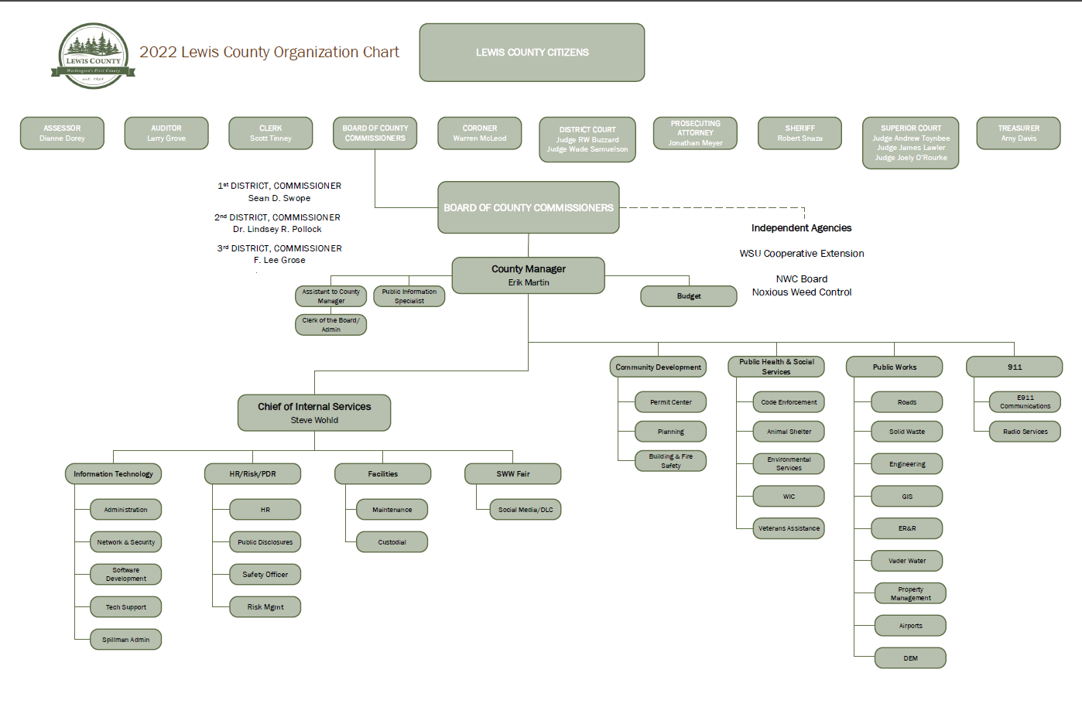
County departments and offices

Slide 7
Lewis County budget outlook
Property tax increase limited to one percent growth plus new construction and any increases in state assessed utilities
The Assessor estimates county-wide new construction this year at $352 million, down from $467 million in 2021.
The Implicit Price Deflator rate as of September 25, 2022 is 6.457% compared to 3.86% last year
Sales tax revenue is 6.41% above 2021 for collections through August compared to 31% increase in 2021 over 2020.
The Lewis County unemployment rate is 4.7% compared to a WA state rate of 3.7%
According to data from Northwest Multiple Listing Service, the median home price in Lewis County was $427,000 in October, up 25% from a year ago
Stimulus funds allocated to the county and all cities within the county during the pandemic will continue to be used in the community through 2026.
Notes:
Sources Housing - https://wcrer.be.uw.edu/wp-content/uploads/sites/60/2022/05/2022q1Snapshot.pdf
https://www.nar.realtor/research-and-statistics/housing-statistics-and-real-estate-market-trends
https://www.nwmls.com/northwest-mls-brokers-say-motivated-home-buyers-turn-to-creative-financing-options/
https://www.chronline.com/stories/lewis-county-home-prices-increase-in-october-driven-by-declining-inventory,304015
Sources UI Rates https://esd.wa.gov/labormarketinfo/labor-area-summaries

Slide 8
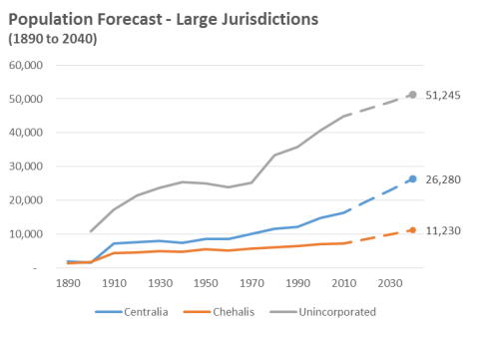
LEWIS COUNTY, WA
COUNTY DETAILS
County Seat: Chehalis
Year Organized: 1845
Total Square Miles: 2,403
2020 Population: 82,149
Persons/Square Mile: 34
2020 CENSUS
Population: 82,149
2010 to 2020 Population Change: 8.87%
Total Housing Units: 35,412
Share Occupied Housing Units: 89.50%
https://lewiscountywa.gov/departments/community-development/adopted-plans/
Notes:
2020 Population per square mile 34.2 (82,149)
2010 Population per square mile 31.4 (75,455)
New population projections are expected to be posted on OFM in the coming weeks.
The 2017 estimates outlined in the county’s comp plan are from The Washington State Office of Financial Management (OFM) and projects that Lewis County will grow to somewhere in the range of 75,046 and 109,145 people by 2040.
https://explorer.naco.org

Slide 9
FUND TYPES
DEBT SERVICE
CAPITAL
ENTERPRISE
SPECIAL REVENUE
GENERAL FUND (Current Expense)
INTERNAL SERVICE
Non-restricted revenue, such as property tax and sales tax
Includes: Administrative Departments (HR, Risk, Budget and County Administration)
Elected Offices (BOCC, Treasurer, Assessor, Coroner, Auditor, Prosecutor, Courts, Clerk, Sheriff)
Hold restricted revenue that is dedicated to a specific use and usually cannot be used for operations in General Fund
Funds are transferred from other funds depending on the type of debt
Emergency Management, Veterans Relief, Social Services, Community Development, Roads, Health, Southwest Washington Fair and Weed Control
Used to track capital projects such as buildings (real estate excise tax [REET] revenue is mainly dedicated to capital improvements)
Supported by fees from a business-type activity that cannot be used for any other activity - Solid Waste, Airports and Vader Water
Charges to other departments / offices for a service provided internally
IT, Fleet, Risk/Insurance and Facilities
Notes:
This budget includes internal service rates which are transfers between funds for services.
These expenditures and revenues are not actual expenditures out, but a way
To account for these activates so that no fund benefits from another fund. RCW 43.09.210.
There are also interfund transfers to and from funds to support operations.

Slide 10
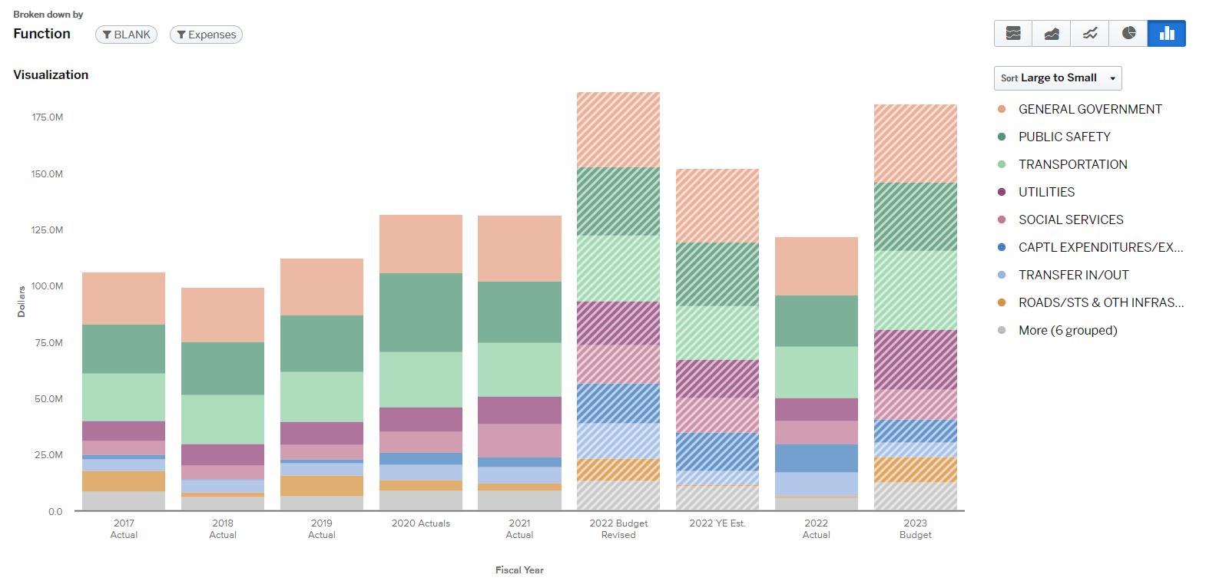
COUNTY BUDGET BY FUNCTION (services)
Notes:
The county budget is reported to the State Auditor's Office by Function.

Slide 11
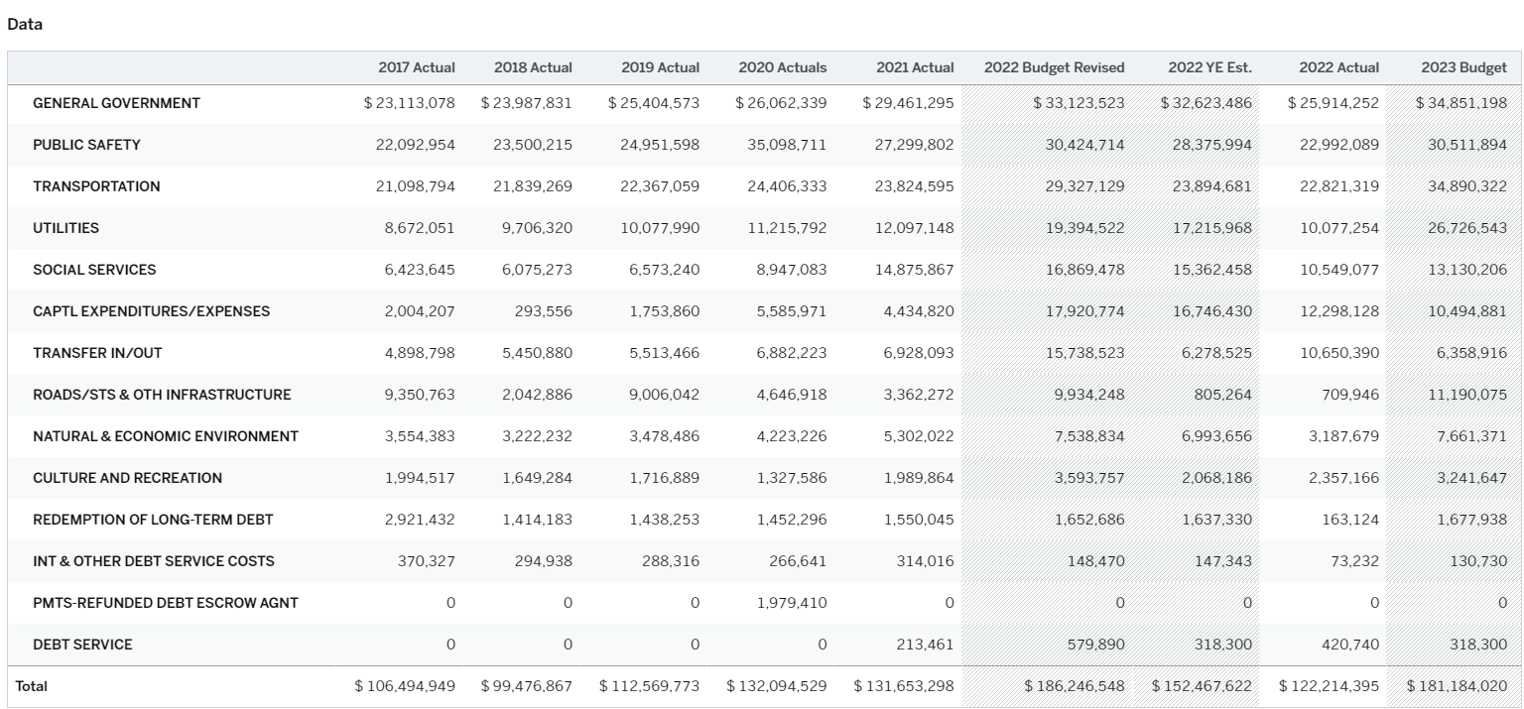
COUNTY BUDGET BY FUNCTION (services)
Notes:
Examples:
Culture and Recreation – WSU Ext, Law Library, Fair, Parks
Debt Service – 2009, 2012 and 2015 debt service payments, Vader Water loan payments and county leases on copy machines
Natural and Economic Environment – Animal Shelter, Community Development, Flood Control, Distressed Counties (.09 funds), Tourism Funds….
Operating Transfers – operating transfers from the General Fund and other transfers between funds include traffic policing, paths and trails, transfer from capital for debt service payments….
Social Services –Veterans Relief, Social Services, MH Health, Coroner….
Utilities – Solid Waste, Disposal District and Vader Water
Capital – Roads Construction, county capital projects ( Juvenile, PH/IT BLDG.) South County and Packwood Airports, Equipment Replacement
Public Safety- Jail, Juvenile, Sheriff, DEM, 911 Dispatch Services, Radio Services….
Transportation – Roads Administration, Maintenance & GIS, Airport Operations, Fleet Services, Pits and Quarries….
General Government – BOCC, Auditor, Elections, Clerk, Treasurer, Prosecutor and Courts, County Administration, IT Services, Facilities Maintenance, General Liability, Unemployment and Workers Comp…..

Slide 12
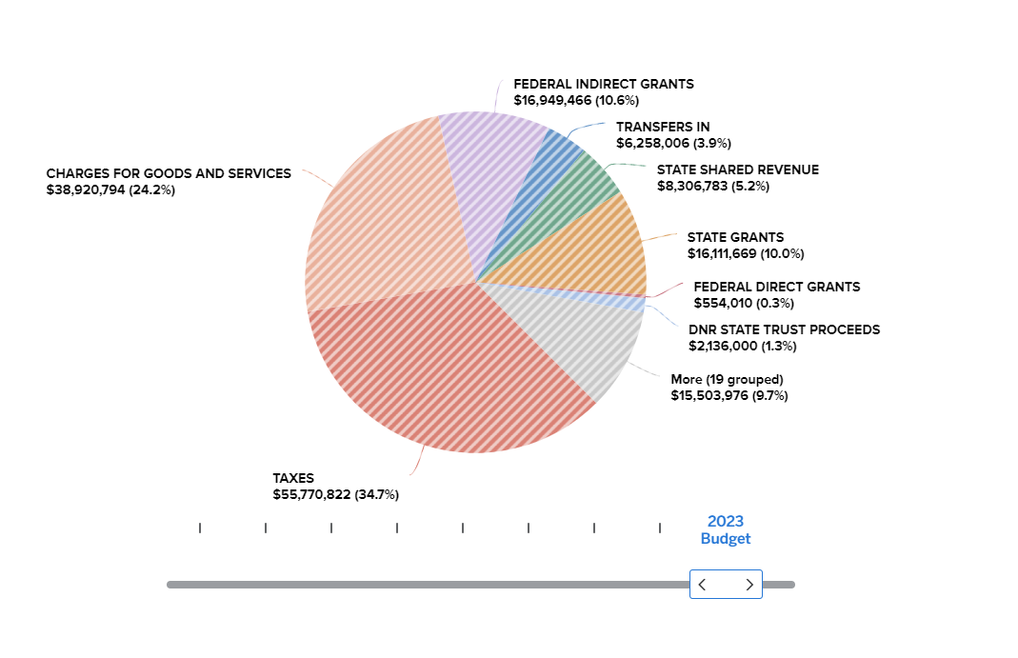
REVENUE SOURCES
All Funds
Total Preliminary Revenue Budget for All Funds is $160,511,526
Notes:
EXAMPLES OF REVENUE BY TYPE:
Taxes: Property, sales and use, timber excise tax
License and Permit: Marriage licenses, motor vehicle licenses, election fees, planning and bldg.
Intergovernmental: Grants and pass through revenue for specific programs
Charges for Services: Funds paid for services rendered to outside agencies for prisoner care as well as interfund charges for internal Services. Solid Waste fees, Dispatch fees etc.
Fines and Forfeitures: Mainly funds collected by District Court and Clerk
Miscellaneous Revenue: Interest on investments, interest on late payments, civil reimbursements
Other Financing Sources: Forest Board Yield revenue

Slide 13
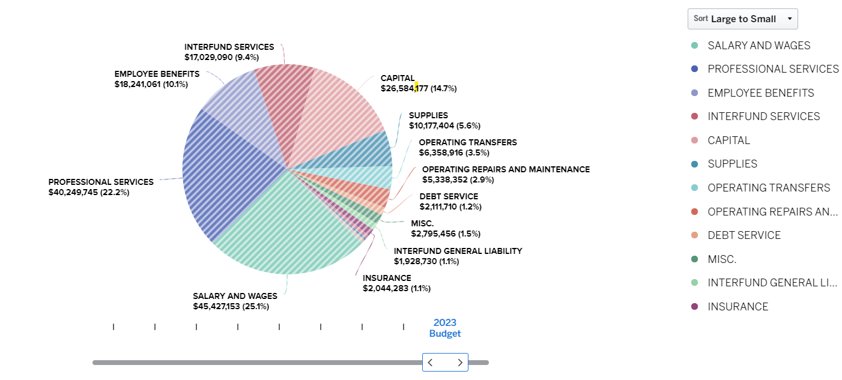
EXPENDITURE (USES) ALL Funds
Total Preliminary Expenditures Budget for All Funds is $181,184,020
Notes:
Salaries: Salary, wages, overtime and extra help (casual)
Benefits: FICA, Health, Industrial Insurance and Retirement
Supplies: Road Supplies, bldg. maintenance supplies, office and operating supplies, small tools and minor equipment
Other Services: Professional Service contracts, Communications, Travel, Advertising, Operating rentals, Insurance, Utilities and repairs and maintenance
Intergovernmental: Payments made to outside agencies reimbursement payments for WSU extension etc… (SAO has eliminated this account as of 2019 in most cases)
Capital: Road Construction projects, County Building Repairs, Capital Planning and finance system
Inter-fund: Payments made to internal service funds. Services include Information Technology, Facilities and Fleet Services
Transfers: Transfers to other funds for Public Health, Emergency Management, Community Development planning services as well as traffic policing from Roads
Debt Service: Bond payments for Historic Courthouse , Jail and loan payments for Vader Water System as well as leases on copy machines

Slide 14
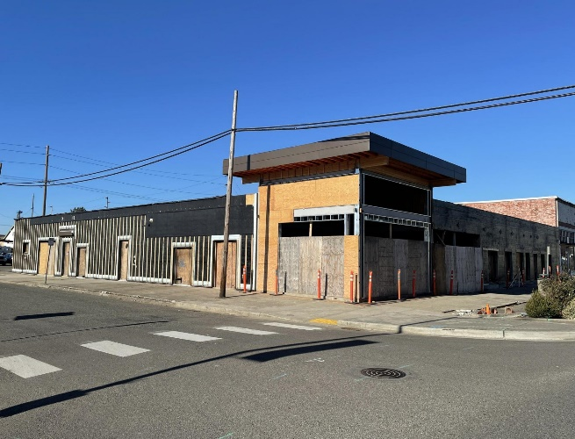
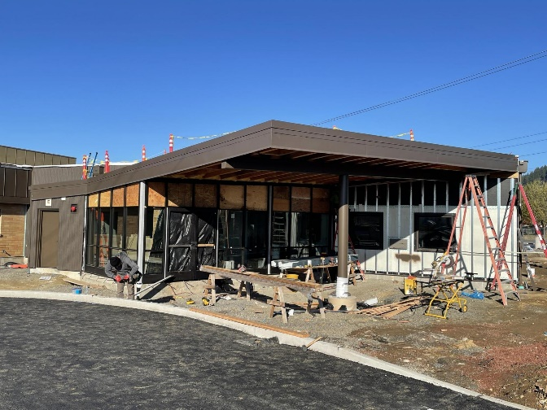
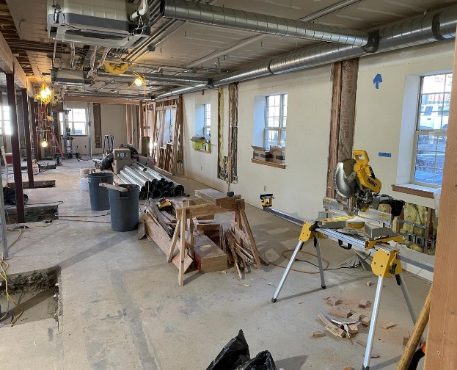
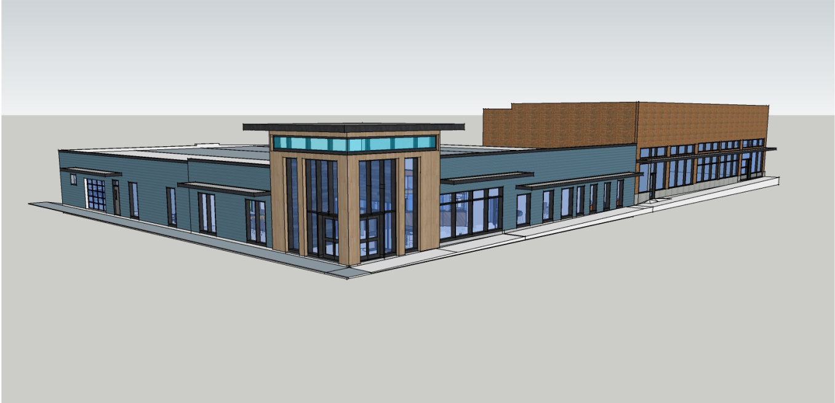
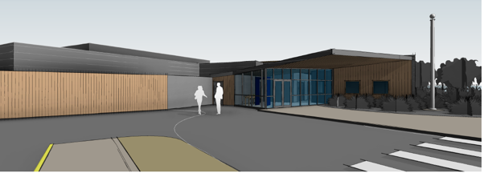
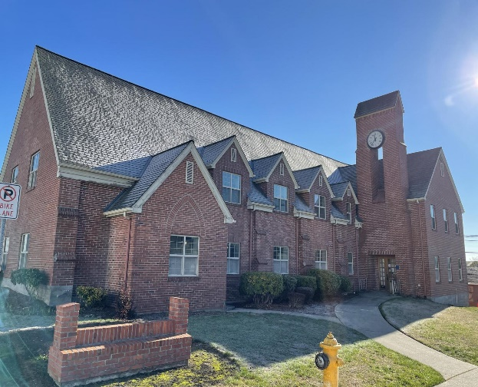
County Campus
Capital projects
Community Development
Juvenile Court
Public Works
Notes:
The county has invested bond funds and local tax funds into several projects this year with
Work continuing into 2023. Three major projects are shown here including the Juvenile
Remodel project, new Public Works and Community Development locations. The current PW and Comm
Dev projects will be repurposed for a new Animals Shelter site and night by night shelter.
Juvenile completion Mid- January 2023
Community Development Completion-April 2023-depending on supply chain
Public Works Completions January - supply chain dependent

Slide 15
GENERAL FUND OFFICES AND DEPARTMENTS
ELECTED OFFICES | DEPARTMENTS | DEPARTMENTS
Board of County Commissioners Auditor / Elections Assessor Treasurer Clerk Superior Court District Court Prosecuting Attorney Sheriff Coroner | Human Resources County Administration Central Services Admin. Weed Control Services Animal Shelter WSU Extension Jail (Sheriff oversight) Juvenile (Superior Court oversight) Self-Insurance Court Security Blake Decision | Board of Equalization Public Defense/Trial Court Improvement Civil Service Disability Board State Examiner WACO & WSAC Boundary Review Board Senior Facilities Transfers Air Pollution
There are 31 Departments and Offices in the General Fund

Slide 16
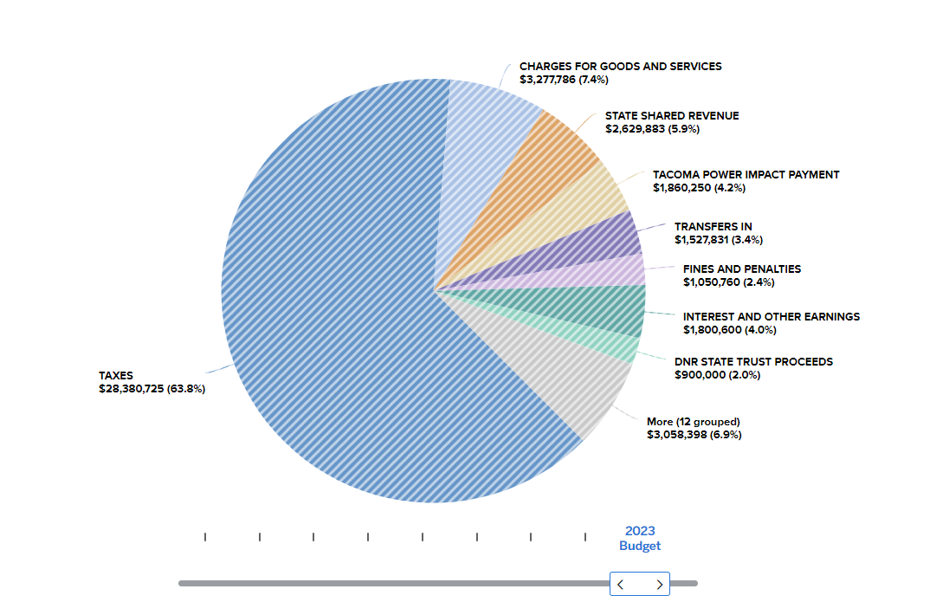
General Fund
REVENUE SOURCES
Total Preliminary General Fund Budget for Revenue is $44,486,233
Notes:
Taxes cover over 63.8% of the operating costs. Sales tax has seen a significant increase over prior years.
Property tax remains capped at 1% or the IPD plus new construction and any increases in State Assessed Utilities.
For 2022 The implicit price deflator (IPD) rose from 3.860% as of September 2021 to over 6% as of September 2022 .

Slide 17
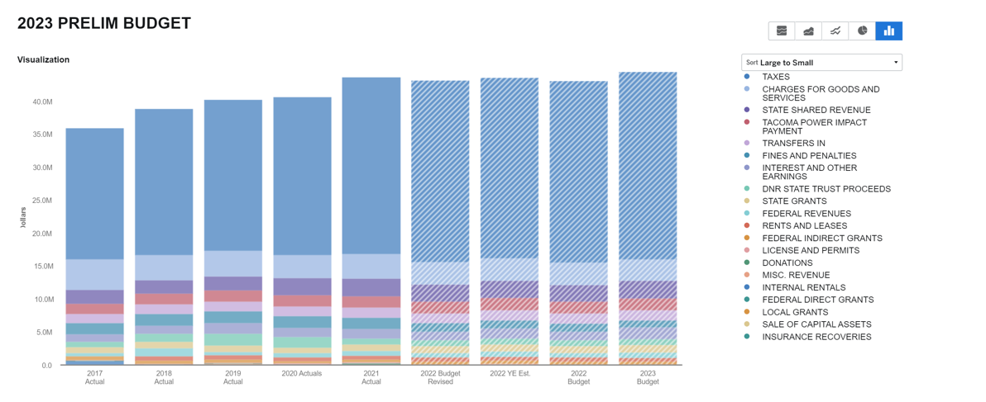
General Fund Revenue History
Notes:
Lewis County has 15 Elected Officials
The County Manager oversees several departments under the BOCC including internal services, 911, Public Works, Community Development and Public Health and oversees the budget process for the County.

Slide 18
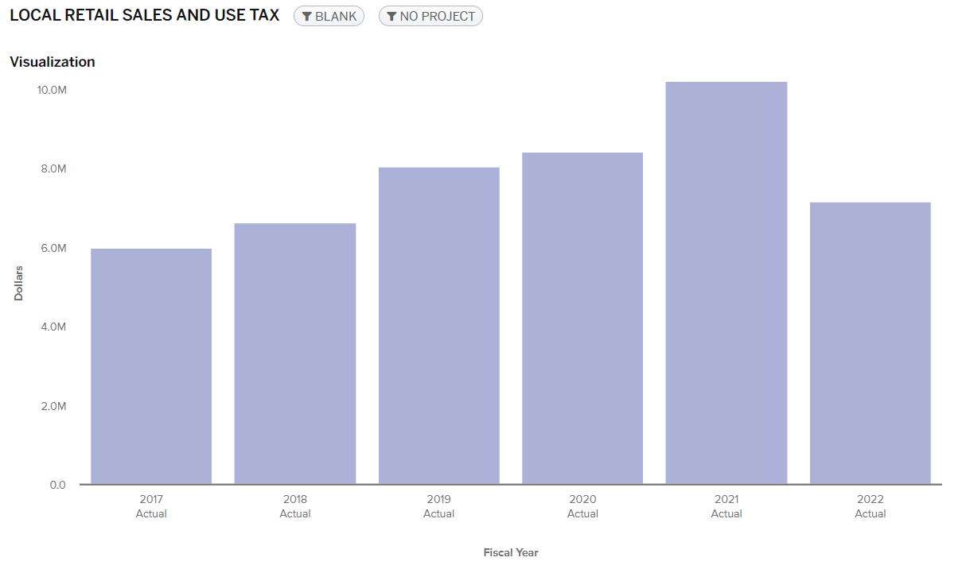
General & optional sales tax receipts
Includes 3.5% allocated to capital projects
Notes:
Sales and use tax actuals through 2022 are 7.1 million – 2021 was $6.7 million an increase of $431K
The graph above shows 2021 Actuals through Dec.

Slide 19
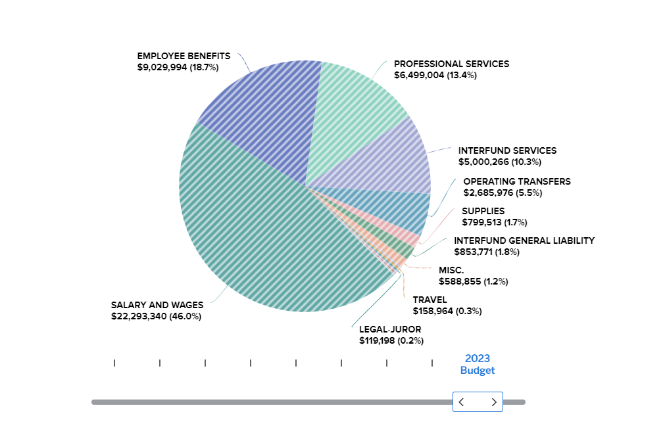
General Fund
EXPENDITURES
Total Preliminary General Fund Budget for Expenditures is $48,416,067
Notes:
The graph shows the % of costs by type
Total salaries and Benefits combined are 64.7% for the general fund budget.
597 FTE’s including 15 elected officials as well as benefits for LEOFF 1 medical for $214K
Interfund transfers out account for $2.6 million of the GF budget. and on the revenue side there are transfer
From the Road fund for traffic policing.
The BOCC approved an additional 2% COLA for 2022 and another 4% COLA January 2023

Slide 20
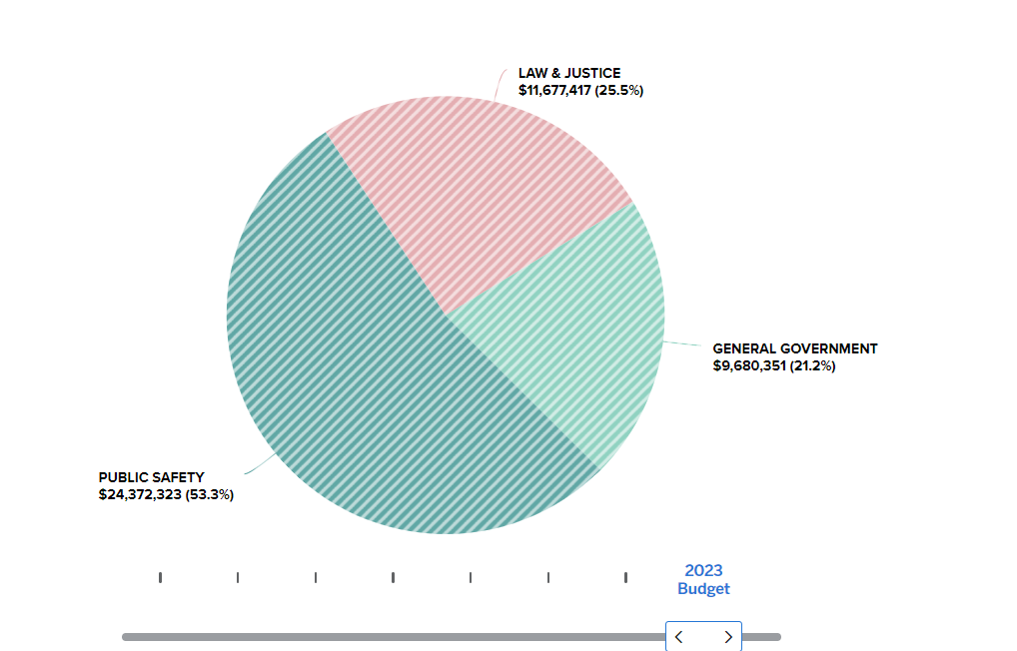
General Fund
EXPENDITURES by function
EXPENDITURES BY FUNCTION
Public Safety Sheriff Jail Juvenile Coroner Civil Service Law & Justice Prosecuting Attorney District Court Courts: Designated Accounts Superior Court Clerk | General Government Assessor Auditor Commissioners Treasurer Animal Shelter Elections Human Resources County Administration Self-Insurance WSU Extension Senior Services State Examiner WACO & WSAC Air Pollution Control Central Services Board of Equalization Boundary Review Board Disability Board Blake Court Security
The chart above does not include operating transfers out of $2.6 Million
Notes:
Public Safety: Sheriff, Jail, Juvenile Detention and Civil Service
Law and Justice: Superior Court, District Court, Clerk’s Office, Indigent Defense ( PS and LJ combined are 78.8%)
Administration: BOCC, Auditor, Treasurer, Assessor, Risk, Central Services Administration, County Admin., Budget Services, Human Resources, & WSU Ext…

Slide 21
Summary of preliminary budget
REVENUE
EXPENDITURES
Fund Category | 2022 Revised Rev. Budget | 2023 Preliminary Rev. Budget
General Fund | 43,253,361 | 44,486,233
¹ Special Revenue | 72,321,621 | 64,130,329
Debt Service | 1,954,879 | 1,954,879
² Capital | 17,992,628 | 16,211,510
Enterprise | 13,871,792 | 18,544,786
Internal Service | 14,862,383 | 15,183,789
Total All Funds | 164,256,664 | 160,511,526
Fund Category | 2022 Revised Exp. Budget | 2023 Preliminary Exp. Budget
General Fund | 47,280,535 | 48,416,067
Special Revenue | 76,603,112 | 78,368,928
Debt Service | 1,954,878 | 1,951,513
Capital | 31,308,967 | 17,104,525
Enterprise | 13,731,234 | 18,436,925
Internal Service | 15,367,822 | 16,906,063
Total All Funds | 186,246,548 | 181,184,021
1- Special Revenue includes $9.8 million in federal stimulus funds
2- Capital Funds include $9.3 million on WSBO- ARPA grant funds for Broadband Expansion in Winlock
Notes:
The 2023 Prelim budgeted use of Fund balance is 3.9 million for the General Fund
The 2022 Prelim budgeted use of fund balance is $2.5 million for the General Fund
For 2022, early estimates provided by offices and departments project the General fund to use fund balance of $2.3 million. These estimates are likely to change as we near year-end. Based on a more recent review of turn back for vacant positions this number is likely to be reduced. Actual 2022 revenues and expenditures will be available near the end of February. The County is accrual based and will keep the books open for 60 days to account for all 2022 revenue and expenses.
Note - Sales and use tax is a two month lag
The average savings from vacant positions is 500 to 1. million
Timber Excise tax is projected to result in one-time excess funds to General Fund and the Road fund – the BOCC has approved moving these one-time funds to a new Technology Replacement Fund. This fund will be used to plan and fund the replacement of necessary technology systems in the county.

Slide 22
County employee summary
Notes:
This chart does not include positions added this week.
Positions added back in 2021/2022 are the largely due to new projects and funding sources.
New funding for construction using bond funds
ARPA funding for projects
Approved 2022 budget requests ( Sheriff, Assessor, Auditor, Animal Shelter etc. )
New housing and infrastructure spec.
PH – COVID funding and new grants
Parks and Rec/ Fair changes

Slide 23
Budget increase Requests
Office/Department Name: | Amount Requested: | Amount Approved
Treasurer | 3,500.00 | 3,500
Assessor | 96,170.00 | 0.00
Assessor | 90,528.00 | 0.00
Superior Court | 22,183.00 | 22,183
Jail | 338,016.00 | 112,672
Sheriff | 496,921.00 | 29,067
Parks and Recreation | 385,000.00 | 152,000
Public Health | 3,360.00 | 3,360
Public Health | 93,500.00 | 93,500
Public Health | 6,806.00 | 6,803
Public Health | 10,400.00 | 10,400
Public Health | 115,800.00 | 115,800
Public Health | 101,000.00 | 101,000
Public Health | 192,000.00 | 192,000
Public Health | 69,600.00 | 69,600
Coroner | 21,000.00 | 0.00
Coroner | 38,378.00 | 1,760
Total | 2,084,162 | 913,645
The BOCC received budget increase requests from offices and departments above the Preliminary Budget totaling $2,084,162
As of 11/21/2022 the BOCC has approved $913,645. The General Fund impact from the total approved is $414,682.
Notes:
Budget items also approved not listed above include continued support of the Lewis County Seniors
Nutrition program of $100K and an added positions for public defense as required by a Supreme Court ruling

Slide 24
Fund Balance
Fund Balance Review
$14.7 million Fund Balance including - $1.5 reserve
$2.3 million estimated use of fund balance as submitted by offices and departments for YE 2022
$12.4 million estimated 2022 YE/2023 beginning Fund Balance
$3.9 million budgeted use in the preliminary 2023 budget
$8.5 million estimated (Budgeted)Fund Balance
Revenue Changes to the Preliminary
Investment Interest revenue $350K
Property Taxes – New Construction and State Assessed Utilities only $TBD
Expenditure Changes to the Preliminary
Interfund Rates $183k
New Public Defense Coordinator $98K
Approved budget increase requests $414K
Notes:
The county budgets for all positions – we will have unexpended expenditures for vacancies
In 2021 the General Fund had close to $900K in unexpended sal and Benefits- Current Variance for 2022 YTD October is a little over $1 million in salaries alone. We anticipate the YE projection of 2.3 million for use of fund balance to be lower than initially projected. YE actuals will not be known until the beginning of March due to the accruals period for revenue and expenditures.
Review of Investment interest revenue will be done at the next Finance Committee Meeting. This change will be a positive impact to the General Fund.
The county budgets for all positions to be filled. Often times the county has significant savings
in salary and benefits due to vacant positions. The county typically budgets revenue based
on known revenues and trends for sales and use tax. Timber revenues can be unpredictable and are budgeted conservatively.

Slide 25
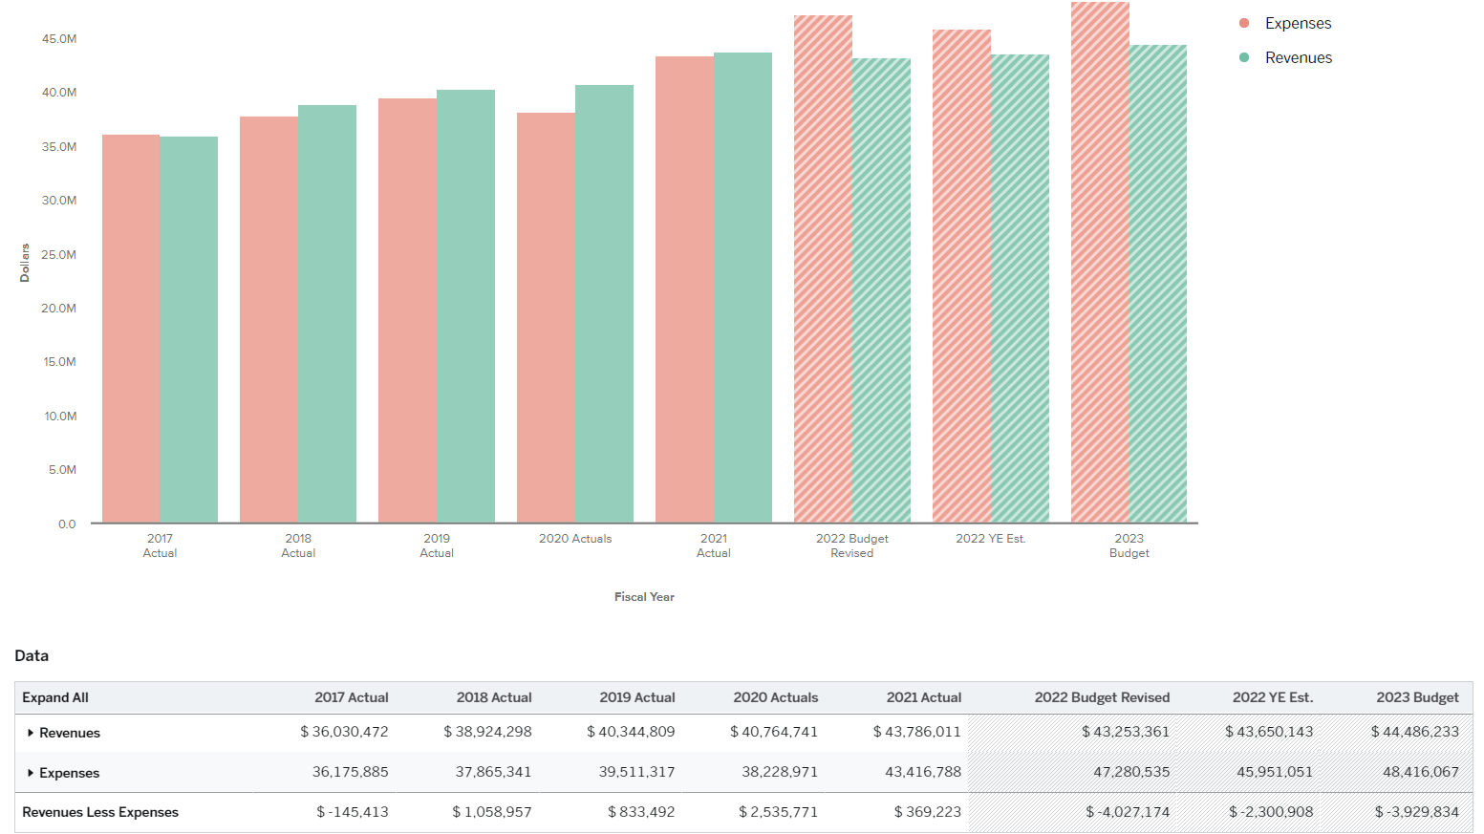
Budget to Actuals comparison
2017 -2021 Actuals
2022 Estimates
2023 Preliminary Budget
Notes:
As you can see in the graph here the actual YE numbers often are much different than the actual YE numbers. The Budget is a planning document and plans change throughout the year.
The General Fund balance was $14.7 million at the beginning of 2022
Budgeted use of fund balance in the 2023 prelim is $3.9 Million this will change as the approved changes and adjustments are added to the final budget over the next few days and Resolutions will be updated to show any changes from the Prelim to the Final.

Slide 26
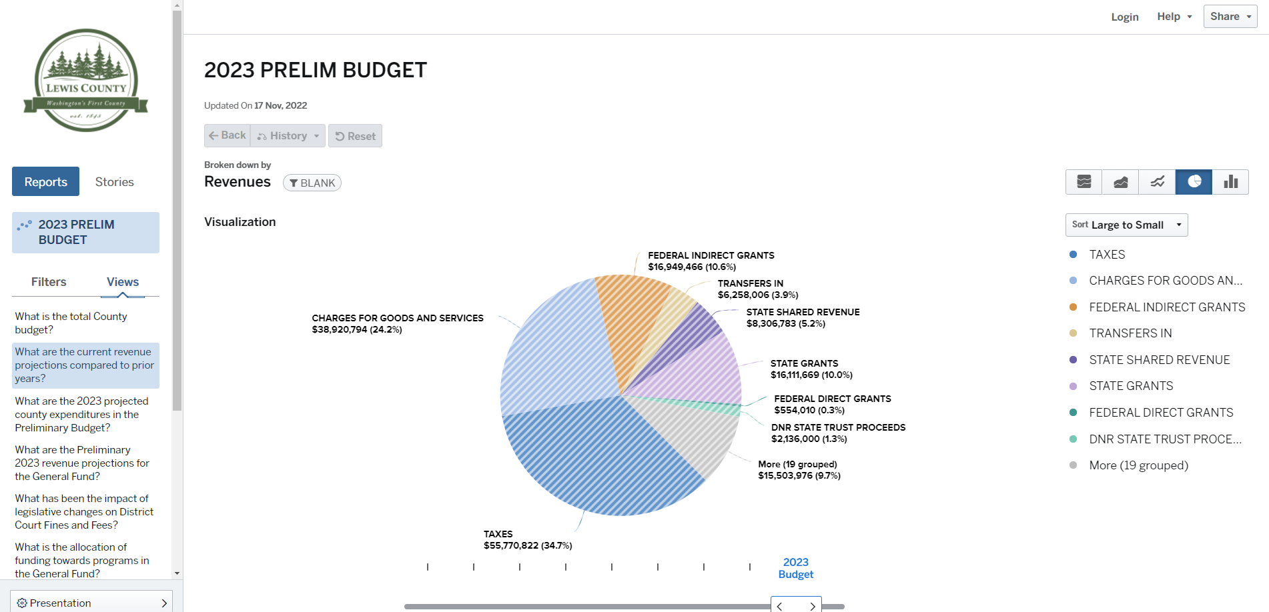
LAUNCH OF OPENGOV FINANCIAL
TRANSPARENCY PORTAL
https://lewiscountywa.gov/departments/budget/lewis-county-budget/2023-budget/
https://lewiscountywa.opengov.com/
Notes:
The county launched the OpenGov financial Transparency portal for the 2023 Preliminary Budget in October. Data will be update with the final after the hearing.

Slide 27
NEXT STEPS
Incorporate Final Changes:
Property Tax budget updates for new construction, state-assessed utilities and 0%-1% increase.
Update the Final Budget for BOCC-approved department and office budget increase requests, new revenue projections and grant funds.
Final Budget Hearings 12/5/2022:
Setting property tax levies for both the General and Roads
Adopting the Final 2023 Budget and Capital Plan

Slide 28
American rescue plan funds
$15.6 million State and Local Fiscal Recovery Funds (SLFRF) allocated to Lewis County- Funds must be obligated by 12/2024 and expended by 12/2026. Requires reporting
$3 million Local and Tribal Consistency Fund (LATCF). No end date on the funds- can be used for eligible general governmental services. Requires reporting
Linked to the Strategic Directives outlined in the
five-year Strategic Plan
Focused on creating long-term investments with limited
long-term liability

Slide 29
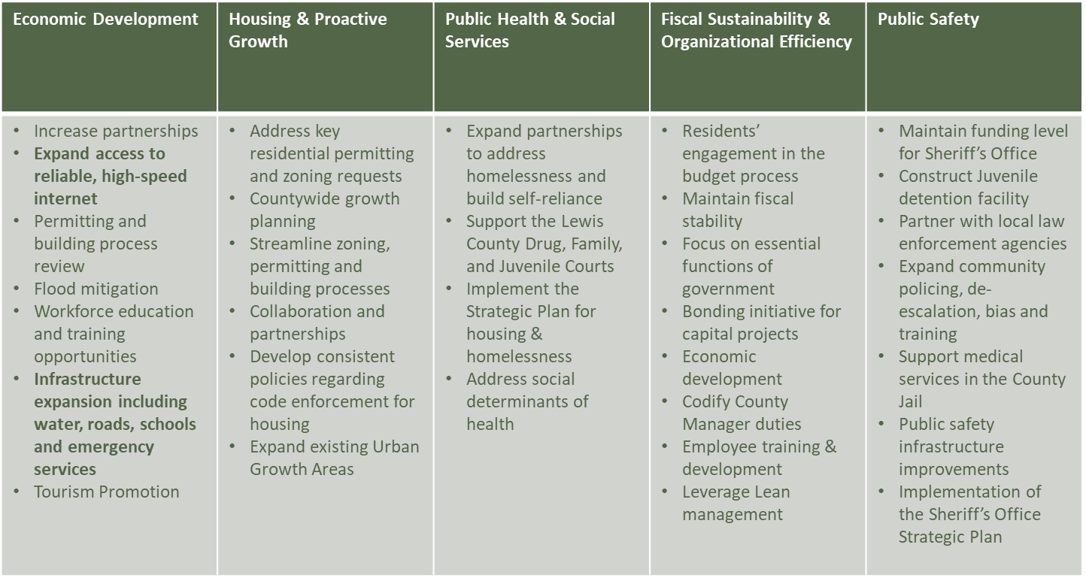
Strategic PLANNING
Vision 2025
Notes:
Discuss long-range strategic plans – in progress

Slide 30

THANK YOU
For questions please contact:
County Manager Erik Martin at 360-740-2697
Budget Administrator Becky Butler at 360-740-1198

